Slide 1
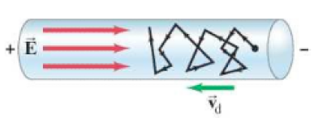
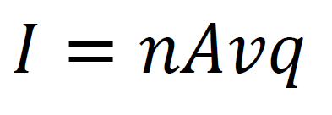
Electron Drift Speed
n – Number of charge carriers per m³ (electrons m⁻³)
A – Cross sectional area of the wire (m²) (πr² ?)
v – Electron drift speed (m/s)
q – Charge on one charge carrier (C)

Slide 2
Ex #1: A 2.4 mm diameter copper (n = 8.5x10²⁸ carriers/m³) wire has a current of 5.8 amps flowing down it. What is the electron drift speed? (9.4x10⁻⁵ m/s) (difference between drift speed and signal speed)

Slide 3
Whiteboards
1 | 2 | 3

Slide 4
A 1.8 mm diameter copper (n = 8.5x10²⁸ carriers/m³) wire has an electron drift speed of 0.082 mm/s. What is the current flowing in the wire?
2.8 Amps

Slide 5
A 3.4 mm wire of some material has an electron drift velocity of 0.016 mm/s when a current of 12 A flows. What is the density of charge carriers per cubic meter?
5.2x10²⁹ carriers/m³

Slide 6
A copper (n = 8.5x10²⁸ carriers/m³) wire carrying 4.5 A has an electron drift speed of 0.13 mm/s. What is the diameter of the wire?
1.8 mm

