Slide 1
Oscilloscopes

Slide 2
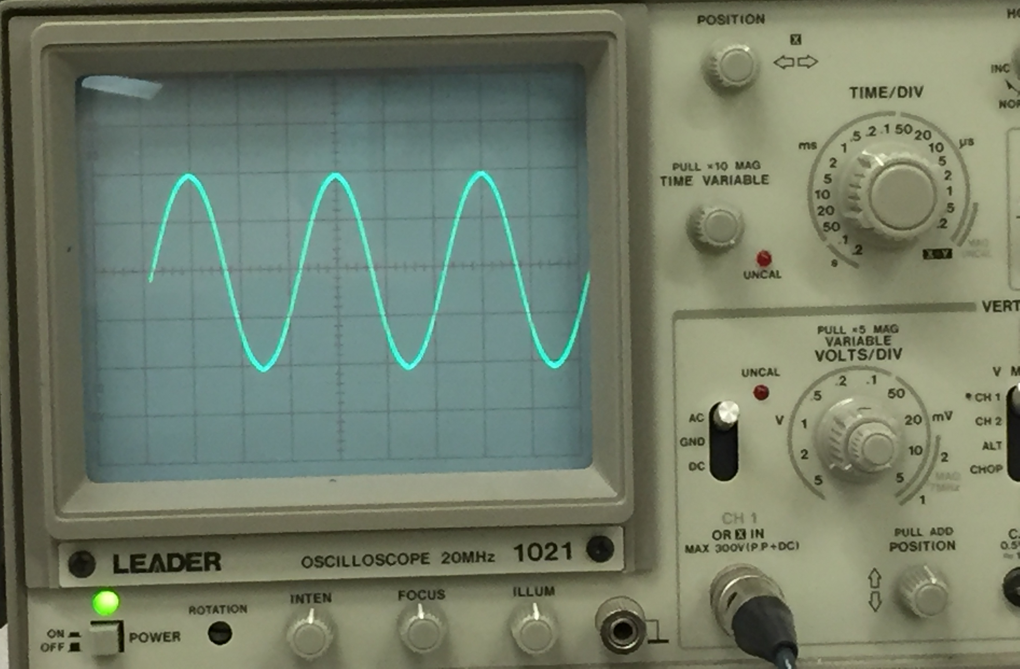

Slide 3
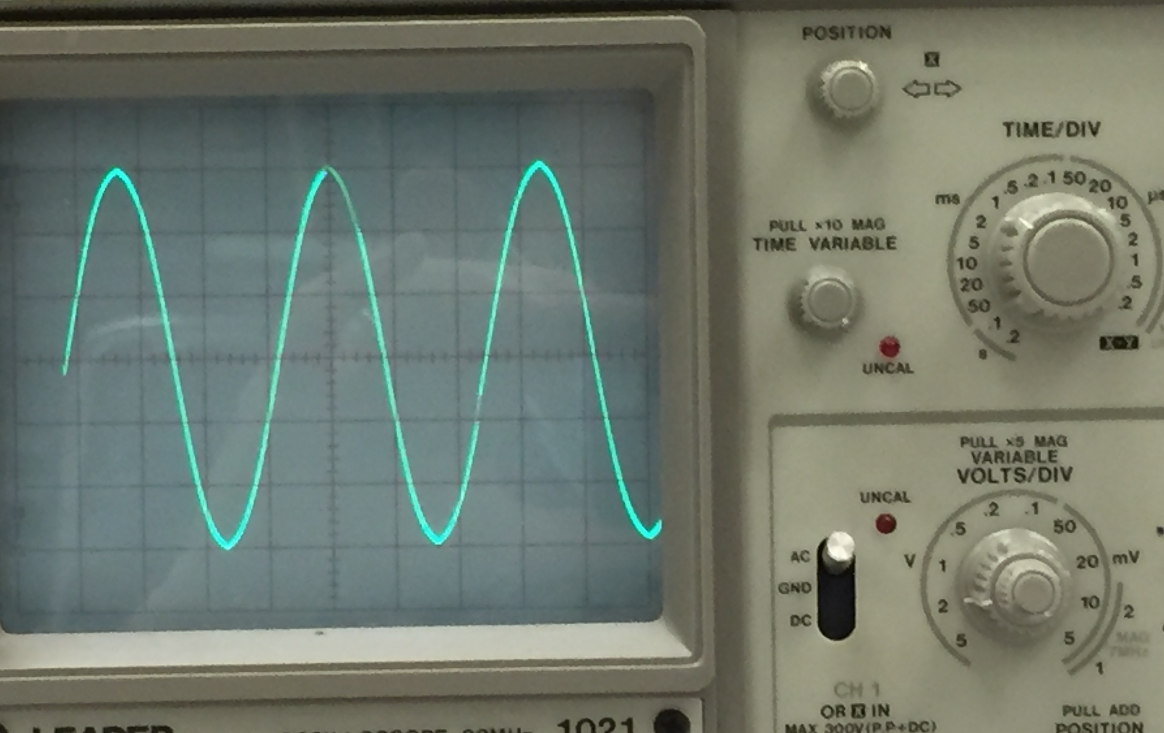

Slide 4
