Slide 1
Kirchoff’s Laws
Junction
Loop
Example

Slide 2
Kirchoff’s laws
1. For a junction, ΣI_{in} = ΣI_{out} (Junction law = conservation of charge)
2. For a complete loop, ΣΔV = 0 (Conservation of energy)

Slide 3
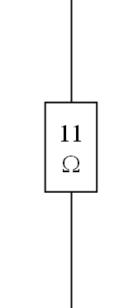
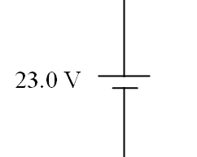
Kirchoff’s laws
2. For a complete loop, ΣΔV = 0 (Conservation of energy)
For Batteries:
For Resistors:
I

Slide 4
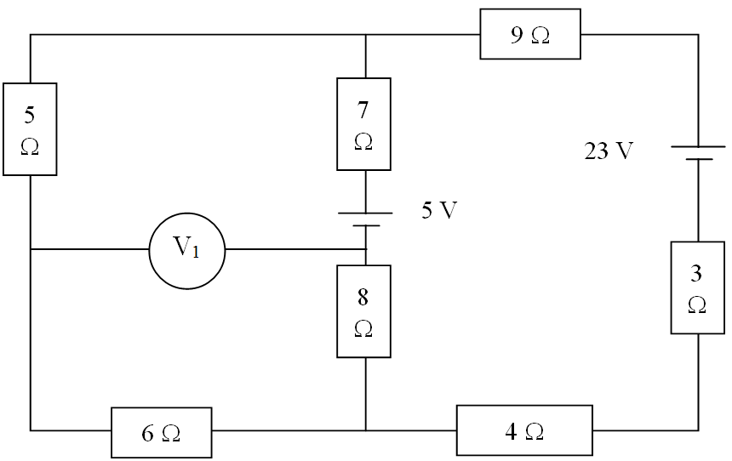
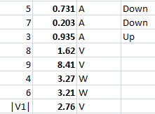
Find Current
5 Ω
7 Ω
3 Ω
Voltage across:
8 Ω
9 Ω
Power dissipated:
4 Ω
6 Ω
|V₁|

