Slide 1
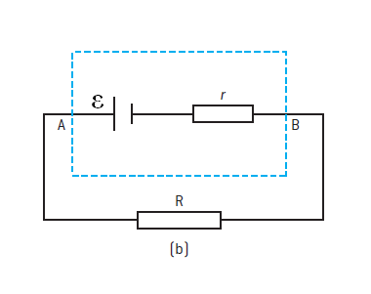
Terminal Voltage of a Battery
ε – The EMF of the cell. (Volts)
I – The current drawn from the cell (Amps)
R – The external resistance that is applied to the battery (Ohms)
r – The internal resistance of the battery (Ohms)

Slide 2
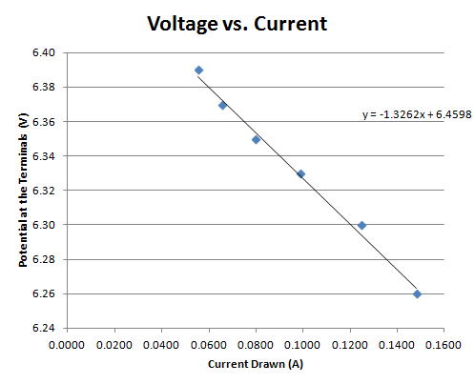
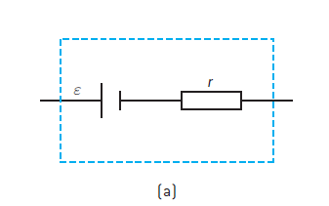

Slide 3
Example 1
A battery with an EMF of 6.00 V has an internal resistance of 0.145 ohms. What current flows when it is connected to a light bulb with a resistance of 3.60 ohms? What is the voltage across the light bulb?
(1.60 amps, 5.77V)

Slide 4
Example 2
An alkaline battery has an internal resistance of 0.256 ohms, and an EMF of 4.50 volts. What is the terminal voltage of the battery if there is 890 mA flowing from the battery? (4.27 V)

Slide 5
Example 3
A lead acid battery has an EMF of 12.00 volts. What is the internal resistance of the battery if the terminal voltage is 10.45 V when there is 76.0 amps of current flowing? (20.4 milliohms)

Slide 6
Whiteboards
1 | 2 | 3

Slide 7
A battery has an internal resistance of 0.437 ohms and an EMF of 9.00 V. What is the terminal voltage if the external circuit is drawing 1.50 amps of current?
8.34 V

Slide 8
A battery has an EMF of 1.50 Volts and an internal resistance of 0.312 ohms. What current is flowing if the terminal voltage has dropped to 1.32 V?
577 mA

Slide 9
A lead acid battery has an EMF of 12.72 V and an internal resistance of 23.7 milliohms. What is the resistance of the external circuit if the terminal voltage has dropped to 11.85 V?
0.323 ohms

Slide 11
Terminal Voltage

