Slide 1
What is the resistance from black dot to black dot?
16 Ω
5 Ω
12 Ω
16 Ω
R = 5 + 1/(1/16+1/16) + 12 = 25 Ω
25 Ω

Slide 2
What is the resistance from black dot to black dot? (3 SF)
5 Ω
8 Ω
11 Ω
7 Ω
9 Ω
R = 5 + 1/(1/11+1/(8+7)) + 9 = 20.3 Ω
20.3 Ω

Slide 3
What is the resistance from black dot to black dot? (3 SF)
4 Ω
4 Ω
15 Ω
10 Ω
6 Ω
6 Ω
7.5 Ω

Slide 4
Whiteboards

Slide 5
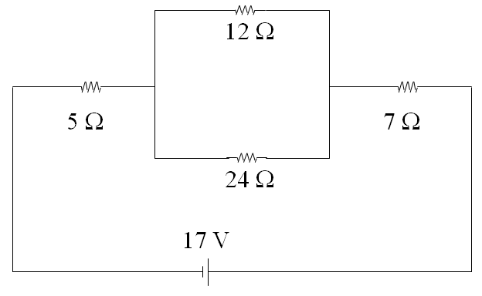
Try to find the resistance that is across the battery in each circuit. Ignore the Voltmeters and Ammeters for now:
20 Ω

Slide 6
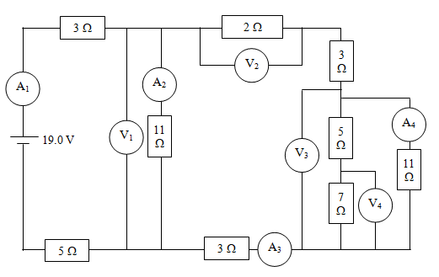
Try to find the resistance that is across the battery in each circuit. Ignore the Voltmeters and Ammeters for now:
14.1 Ω

Slide 7
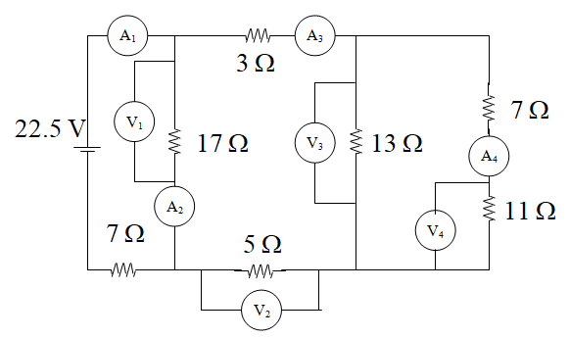
Try to find the resistance that is across the battery in each circuit. Ignore the Voltmeters and Ammeters for now:
15.1 Ω

