Slide 1
Alternating Current and RMS
Derivation
Whiteboards

Slide 2
Alternating Current
Concept 0
V = V_{o}sin(2πft)
I = I_{o}sin(2πft)
V_{o} = Peak V
I_{o} = Peak I
Demo – oscilloscope - what is our V_{o}???

Slide 3
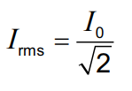
Vac
~
R
P = I²R = V²/R
What Is “effective” I and V?
rms = root mean square
V_{rms} and I_{rms} is default - meters
If people mean “peak”, they will say “peak”
What is our rms on the ‘scope?
Average Power = ¹/₂I_{o}²R = ¹/₂V_{o}²/R

Slide 4
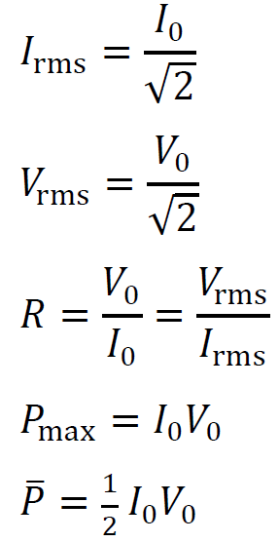

Slide 5
Example - A 13.50 ohm resistor has a peak voltage of 207.0 Volts across it. What is the rms voltage across it, and what is the peak and rms current through it, and the average power and peak power that it dissipates? (V_{rms} = 146.37 V, I_{o} = 15.3333, I_{rms} = 10.84 A, P = 1587 W, P_{o} = 3174 W)

Slide 6
Whiteboards
rms
1 | 2 | 3 | 4 | 5 | 6

Slide 7
What is the rms voltage if the peak voltage is 340 V?
240 V

Slide 8
A circuit has an rms current of 1.45 A. What is the peak current?
2.05 A

Slide 9
What’s the rms voltage here?
+16 V
-16 V
11 V

Slide 10
What is the peak voltage if the rms voltage is 12 V?
17 V

Slide 11
An 60.0 V alternating current is attached to a device that draws 3.5 amps. What is the power used?
210 W

Slide 12
An alternating current with a peak voltage of 18.5 V is connected to a 27.5 ohm resistor. What power is dissipated?
6.22 W

Slide 13
A 40. Watt light is connected to a 120 Volt source. What is the peak current through the light bulb, its resistance, and what is the peak power that it dissipates?
0.47 A, 360 ohms, 80. W

Slide 14
A 100.2 ohm heating element is dissipating 1530 W of power. What are the peak current and peak voltage through and across the element? (find rms…) What is the peak power?
5.5 A, 554 V, 3060 W

