Slide 1
Ohm’s Law
Definition
Whiteboards
An Elaborate Analogy

Slide 2
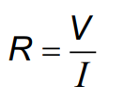
Ohm’s Law
V = Voltage (like pressure)
I = Current (like flow rate)
+
-
A
V
R
R = Resistance in ohms (Ω)
V = Voltage in Volts (V) (pressure)
I = Current in Amps (A) (flowrate)

Slide 3
Ohm’s Law - The way I think of it
V = Voltage (like pressure)
I = Current (like flowrate)
R = Resistance to flow
+
-
A
V
I = V
R
R = Resistance in ohms (Ω)
V = Voltage in Volts (V) (pressure)
I = Current in Amps (A) (flowrate)
R

Slide 4
Ohm’s Law
+
-
A
V
I = V
R
R = Resistance in ohms (Ω)
V = Voltage in Volts (V) (pressure)
I = Current in Amps (A) (flowrate)
R
Black 0
Brown 1
Red 2
Orange 3
Yellow 4
Green 5
Blue 6
Violet 7
Gray 8
White 9
Gold 5%
Silver 10%
No color 20%

Slide 5
Ohm’s Law
+
-
A
12.0 V
120. mA
R= ??
R = Resistance in ohms (Ω)
V = Voltage in Volts (V) (pressure)
I = Current in Amps (A) (flowrate)
Example 1: What is the resistance in the circuit above? (100 Ω)
Example 2: If there is a 220 Ω resistor in the circuit above, what is the current? (0.055 A)

Slide 6
Whiteboards
1 | 2 | 3 | 4 | 5 | 6

Slide 7
What is the resistance of a light bulb if it draws 250 mA of current from a 6.15 V battery? (1000 mA = 1 A)
24.6 Ω

Slide 8
What current will flow if you plug a paperclip with a resistance of 0.065 Ω into a 12 V source?
180 A

Slide 9
What voltage do you need to push 1.5 Amps of current through a 210 ohm resistor?
315 V

Slide 10
What current flows through an 8.1 ohm speaker when there is a voltage of 3.45 V?
0.43 A

Slide 11
An unknown resistor draws 0.0128 Amps of current from a 23.9 V source. What is the resistance?
1870 Ω

Slide 12
A 1200 ohm resistor is hooked up to an unknown voltage source, and it draws 87.5 mA of current. What is the voltage?
105 V

Slide 13
A 670 ohm resistor is connected to a 1.5 V battery. What time will it take for 3.0 C of charge to flow from the battery?
1340 s

Slide 14
A 3.0 V battery with a capacity of 350 mAh (350 milli amp hours) is drained in 4 hours and 27 minutes. What is the resistance of the circuit that it is attached to?
38 Ω

Slide 15
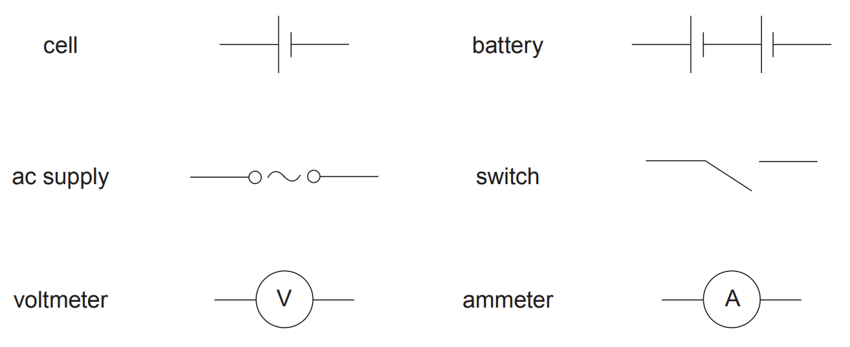
Symbols

Slide 16
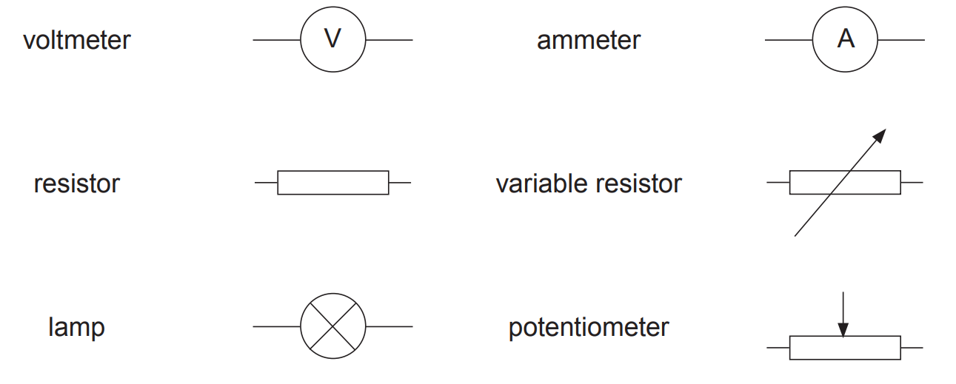
Symbols

Slide 17
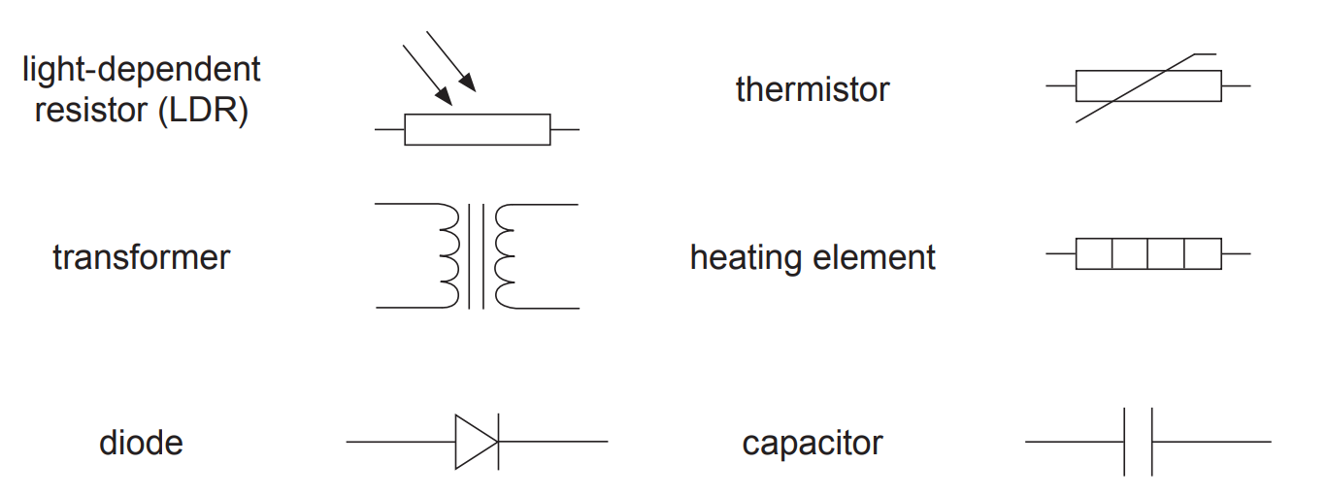

Slide 18
An analogy
Water in pipes: Electrons in wires:
Flow rate (GPM) Current (Amps = C/s)
Pressure Voltage
Constriction Resistance
Constant P Pump Batteries/Cells
Current convention
Restriction
Wires are superconductors
R₁
+
-
A₃
R₂

