Slide 1
Electric Field Lines
Contents:
Basic Concept
Field Lines and point charges
Field Lines and conductors

Slide 2
Electric Field Lines
Point the direction a positive charge would start to move
+
+
+
+
+
+
+
+
+
Direction:
-
-
-
-
-
-
-
-
-
Force This Way
+Q
E
Force This Way
-Q
Parallel Plates

Slide 3
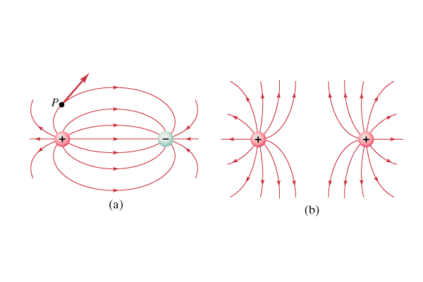
Electric Field Lines
Point the direction a positive charge would start to move

Slide 4
Electric Field Lines
There can be no Electric field within a conductor
(good conductor, static charges)

Slide 5
Electric Field Lines
There can be no Electric field within a conductor
(good conductor, static charges)

Slide 6
Electric Field Lines
Electric Field lines are always perpendicular to the surface of a conductor
Charge would move along the conductor if they weren’t

