Slide 1
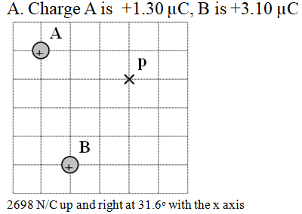

Slide 2
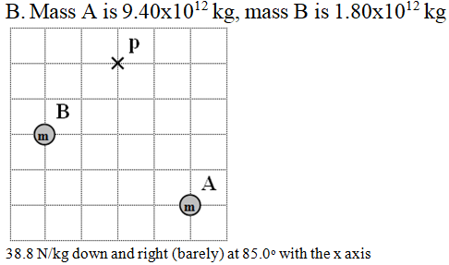

Slide 3
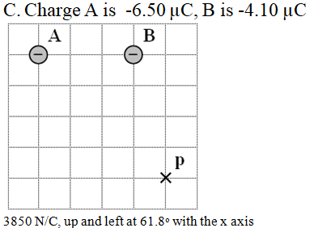

Slide 4
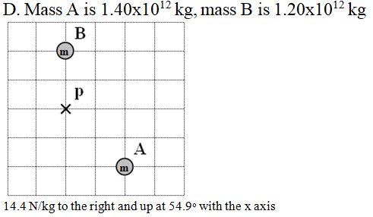

Slide 5
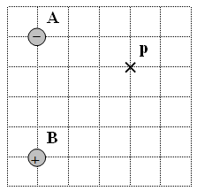
5. Find the electric field at point p. Draw the electric field vector, and label its magnitude and direction. Charge A is -1.80 µC, B is +2.60 µC, and each grid line is a meter.
(1560 N/C left and up at 66.7º with the x axis)

