Slide 1
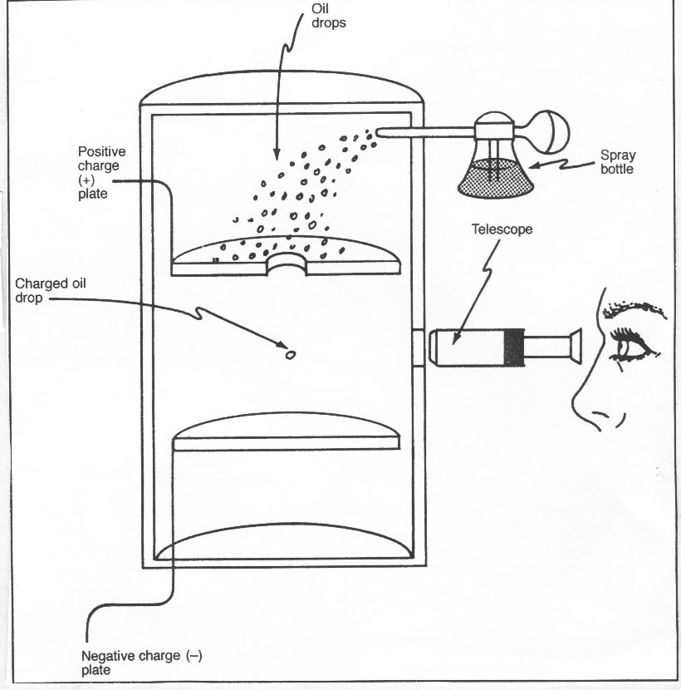
Overview

Slide 2
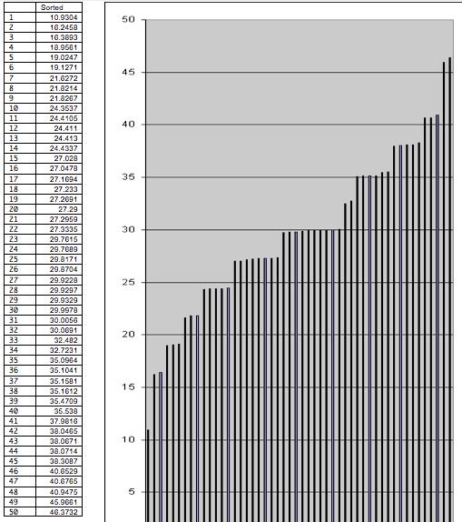
Part 1

Slide 3
Part 2

Slide 4
Part 3

