Slide 1
What work to bring a 2.30 μC charge from 24.0 cm from a
1.50 µC charge to 11.0 cm from a 1.50 μC charge
+1.5 μC
+2.3 μC
24.0 cm
q
q
+1.5 μC
+2.3 μC
11.0 cm
q
q
Find initial voltage
Find final voltage
ΔV = final - initial
W = ΔV_{e}q

Slide 2
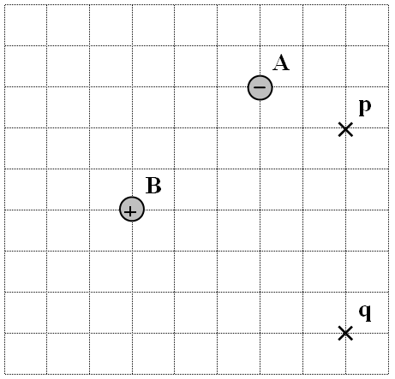
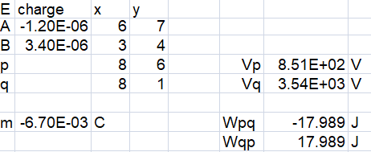
Charge A is -1.20 μC, charge B is +3.40 μC
What work would it take to move a
-6.70x10⁻³C charge from p to q?
-18.0 J

Slide 3
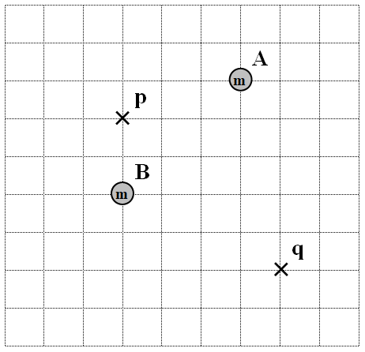
Mass A is 2.30x10¹² kg, mass B is 8.70x10¹² kg
What work would it take to move a 4.50 kg mass from q to p?
-805 J

