Slide 1
Vector Fields Arrays of mass and charge

Slide 4
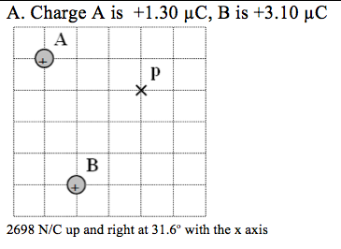

Slide 5
