Slide 1
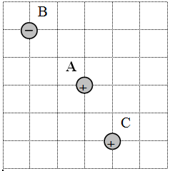
A is +160. µC, and B is -110. µC, and C is +630. µC.
(200. N up and left at 61.6º above the x-axis)

Slide 2
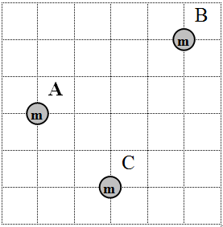
A is 1.60x10⁶ kg, and B is 2.10x10⁶ kg, and C is 6.30x10⁶ kg.
(88.2 N right and down at 38.1º below the x-axis)

