Slide 1
1. A uniform electrical field exerts a force of 0.890 N to the left on a
-410. µC charge. What is the change in electrical potential if you move 2.60 m to the left? Is it an increase in potential, or a decrease?
(5640 V, increase)

Slide 2
2. If you move a mass vertically from point A to point B in a uniform gravitational field, the potential changes from -12.0 J/kg to +23.0 J/kg in a distance of 17.0 m. What force does the field exert on a 5.20 kg mass, and which point is at a higher elevation, A or B? Does the field point toward A or B? (10.7 N, B is higher, toward A)

Slide 3
3. What is the electric field 34.5 cm above a -12.0 μC charge? (9.06x10⁵ N/C down)

Slide 4
4. Find the gravitational field at p and at point q: (p: 9.32 N/kg left, q: 5.91 N/kg left)

Slide 5
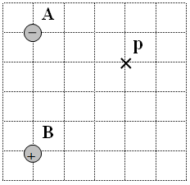
5. Find the electric field at point p. Draw the electric field vector, and label its magnitude and direction. Charge A is -1.80 µC, B is +2.60 µC, and each grid line is a meter. (1560 N/C left and up at 66.7º with the x axis)

