Slide 1
Capacitance
Contents:
Capacitance
Parallel plate capacitors and dielectrics
Energy
RC discharge

Slide 2
Capacitance
C = capacitance (Farads)
q = Charge on the capacitor (C)
V = voltage across the capacitor (V)
+ + + + + + + + + + + + + + + + + + + + + + + + + + + + + + + + + + + + + + + + + + + +
- - - - - - - - - - - - - - - - - - - - - - - - - - - - - - - - - - - - - - - - - - - - - - - - - - - - - - - - - - - - - -

Slide 3
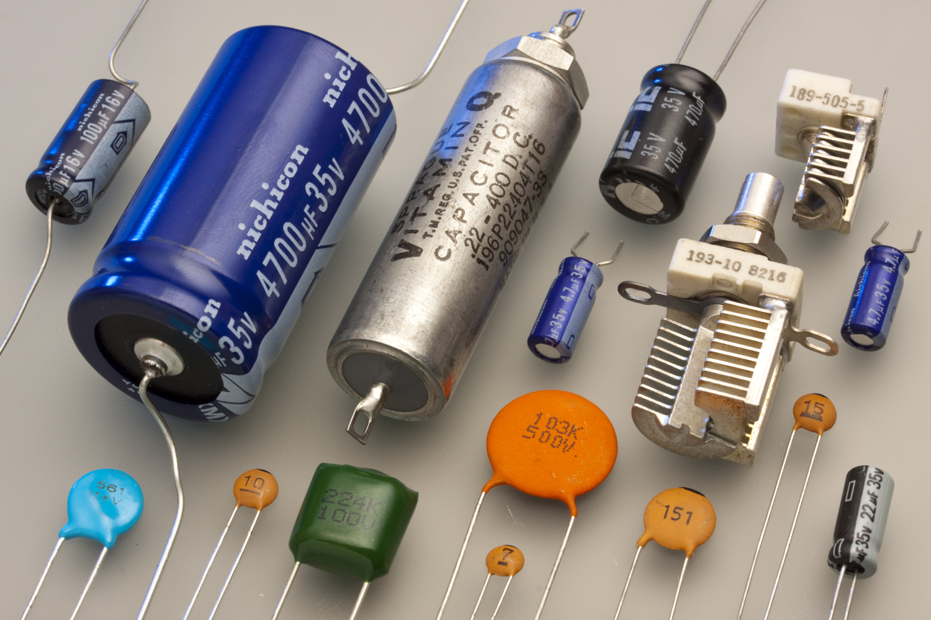
µF = MFD = 10⁻⁶ Farads, small ones are pF = 10⁻¹² F

Slide 4
A CCD pixel has a capacitance of 1.7x10⁻¹² F. What is the voltage across it if it has been charged 6.0x10⁴ electron charges? (1 e = 1.602E-19)
V = q/C = (6.0E11*1.602E-19/1.7E-16) = 5.7 mV

Slide 5
Whiteboards:
Capacitance
1-3

Slide 6
What is the charge on a 250 microfarad capacitor if it has been charged to 12 V?
q = CV = (250E-6 F)(12 V) = 3E-3 Coulombs
0.0030 C

Slide 7
What is the capacitance of a CCD pixel if it has 0.014 V across it when it has a charge of 2.13x10⁻¹⁵ C?
C = q/V = (2.13E-15 C)/(.014 V) = 1.52x10⁻¹³ F
1.5x10⁻¹³ F (or 0.15 pF)

Slide 8
A 45 µF capacitor has 1.2 µC of charge on it. What is the voltage across it?
V = q/C = (2.13E-15 C)/(.014 V) = 0.02666….
27 mV

Slide 9
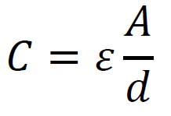
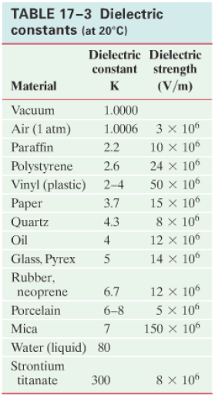
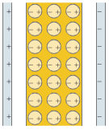
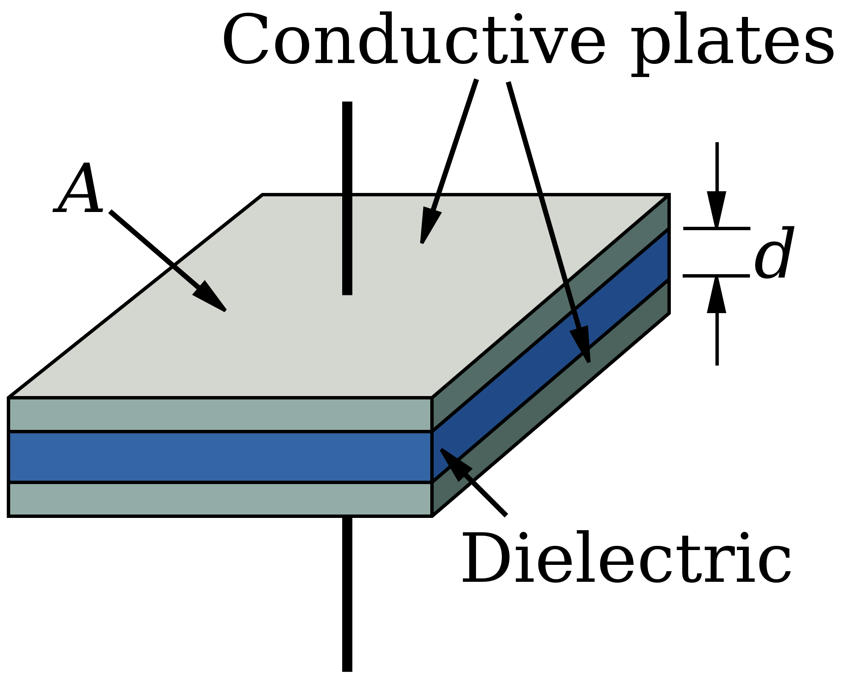
A = plate area (m²)
d = plate separation (m)
ε = permittivity of
dielectric (C²N⁻¹m⁻²)
ε = Kε_{o}
(air ≈ ε_{o} = 8.85x10⁻¹² C²N⁻¹m⁻²)

Slide 10
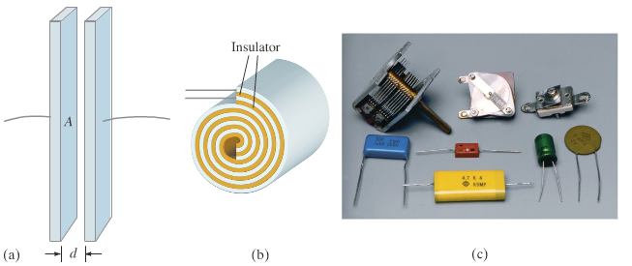

Slide 11
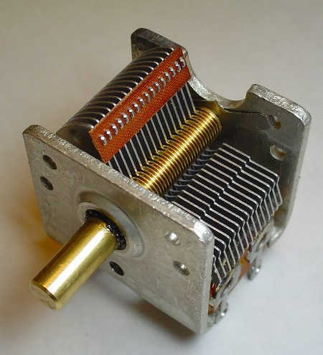
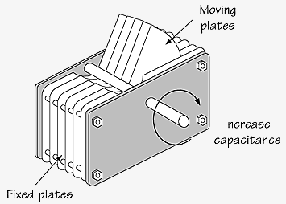
A variable Capacitor
Notice that they change the overlap area

Slide 12
A 3.00 mm air gap capacitor has plates that measure 21.6 cm x 27.9 cm. (8.5”x11”) What is its capacitance?
ε = Kε_{o}
ε_{o} = 8.85x10⁻¹² C²N⁻¹m⁻²
solution
178 pF

Slide 13
Whiteboards:
Capacitance
1-3

Slide 14
A 47 µF electrolytic capacitor uses aluminum oxide as its dielectric (K = 9.1) If it has a plate area of 0.50 cm x 12.00 cm, what must be the thickness of the dielectric?
ε = Kε_{o}
ε_{o} = 8.85x10⁻¹² C²N⁻¹m⁻²
solution
1.0 nm

Slide 15
You are designing a 1400 pF capacitor that must be able to have a peak voltage of 150 V. If you use neoprene as the dielectric,
A. What is the minimum gap you can use?
B. What plate area must you have?
solution
1.25x10⁻⁵ m, 2.94x10⁻⁴ m² (1.7 cm on a side)

Slide 16
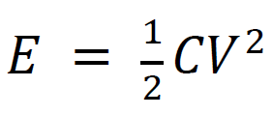
Energy
V
derive 1/2bh
q
A 4500 µF capacitor is charged to 6.0 V. What energy does it store?
(0.081 J) – general where is the energy? Energy density = 1/2εE²

Slide 17
Whiteboards:
Capacitance and energy
1-3

Slide 18
A camera flash requires a stored energy of 1.80 J. To what voltage must it charge a 4700 µF capacitor?
solution
28 V

Slide 19
What sized capacitor do you need to store 15 J of energy at a voltage of 12 V?
solution
0.21 F

Slide 20
What is the potential energy of 0.12 µC stored on an air gap capacitor with a plate area of 25 cm x 25 cm, and a plate separation of 1.0 mm? (Find C, then V, then E)
What happens to the potential energy if the plates are moved so they are 3.0 mm apart? (Same charge)
solution
ε = Kε_{o}
ε_{o} = 8.85x10⁻¹² C²N⁻¹m⁻²
1.3x10⁻⁵ J, 3.9x10⁻⁵ J

Slide 21
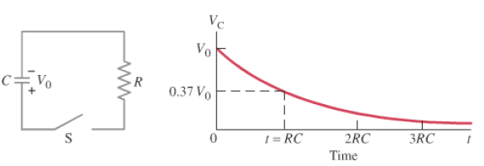
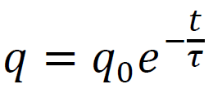
Discharge
demo - RC
R is in V/A, C is in C/V
V = electrical potential (V)
V_{o} = initial (etc)
q = charge (C)
I = current (Amperes A (C/s))
t = time (s)
R = resistance (ohms Ω (V/A))
C = capacitance (F)

Slide 22
A 47.0 μF capacitor is charged to 12.0 V initially, and discharged through a 100. kΩ resistor.
What is its voltage at 13.0 s into the discharge? (0.755 V)
At what time does it reach 6.0 V? (3.26 s)

Slide 23
Whiteboards:
RC decay
1-4

Slide 24
A 100. µF capacitor is attached in parallel with a 1.00 MΩ resistor. If it is initially charged to 5.00 V, what is the voltage 35.0 seconds after it starts to discharge?
solution
3.52 V

Slide 25
A 4.7 µF capacitor is attached to a 2.2 MΩ resistor in parallel. After 78 seconds of discharge there is 0.023 µC of charge on the capacitor. What was the original charge?
solution
43 µC

Slide 26
A discharging parallel RC circuit starts at 12.00 V, and after 312 s has reached 4.00 V. A. What is the time constant? B. What is the resistance if the capacitor has a value of 22.0 µF?
solution
284 s, 12.9 MΩ

Slide 27
A discharging parallel RC circuit has an initial discharge current of 195 mA, and is at a current of 162 mA at a time of 35.0 seconds into its discharge. What will be the current at 72.0 s?
solution
133 mA

