Slide 1
Vector Fields Linear Arrays of mass and charge

Slide 2
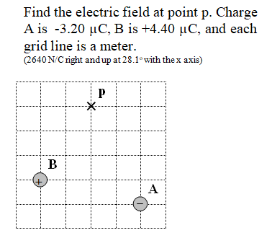

Slide 3
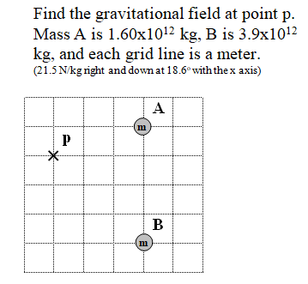

Slide 4
