Slide 1
Basic Thermo

Slide 2
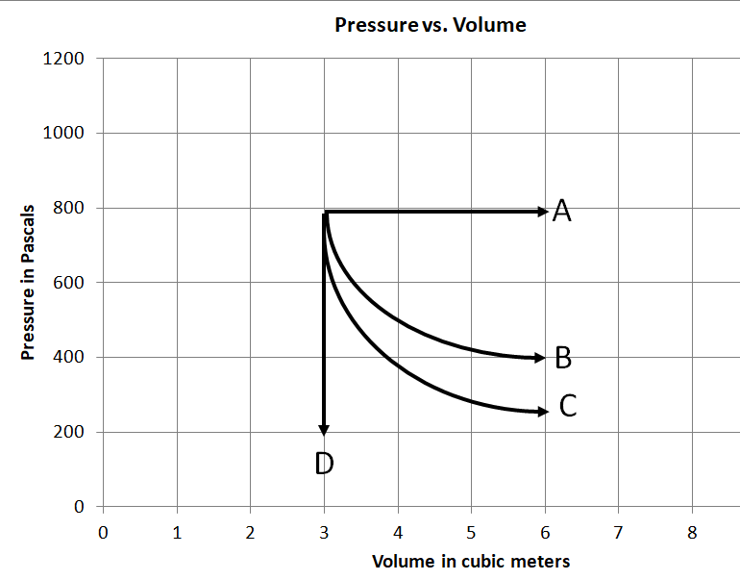
Point X (3.0 m³, 800 Pa) is at a temperature of 400. K
How many Moles of gas do we have? (0.7220216606 moles)
X
For Process XA, what is the Q, ΔU, W?
6000 J, 3600 J, 2400 J

Slide 3
Point X (3.0 m³, 800 Pa) is at a temperature of 400. K
How many Moles of gas do we have? (0.7220216606 moles)
X
For Process XD, what is the Q, ΔU, W?
-2700 J, -2700 J, 0

Slide 4
X
For Process XB, the gas does 1,664 J of work. What is the Q, ΔU?
1,664 J, 0

Slide 5
X
For Process XC, the gas does 1,332 J of work. What is the Q, ΔU?
0, -1,332 J, 1,332 J

