Slide 1
P-V Diagrams and processes
Contents:
Basic Concept
Example
Whiteboards

Slide 2
P-V diagrams
Isobaric Expansion (+W)
Pressure
Isobaric Compression (-W)
Volume
The axes
Change volume?
Change pressure?
Iso = same
baric = pressure

Slide 3
P-V diagrams
Isobaric Expansion (+W)
Pressure
Isobaric Compression (-W)
Volume
W = P ΔV
ΔU = ³/₂nR Δ T = ³/₂P ΔV (not in the packet)

Slide 4
P-V diagrams
Pressure
Volume
Isochoric = same volume
(closed container)
how does it happen?

Slide 5
P-V diagrams
Pressure
Volume
W = P ΔV = 0
ΔU = ³/₂nR Δ T = ³/₂ΔPV (not in the packet)

Slide 6
Adiabatic (no heat flow) processes
Pressure
Volume
Adiabatic expansion: (Q = 0)
Work is done by the gas (+W)
No heat flows in: Q = ΔU + W
0 = ΔU + W, ΔU = -W
Internal energy (T) drops
Examples
Air rockets
Cold side of fridge
Universe
Demo - cloud

Slide 7
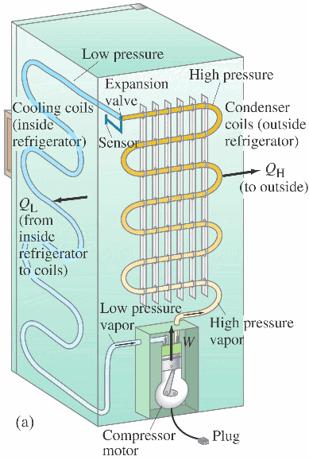
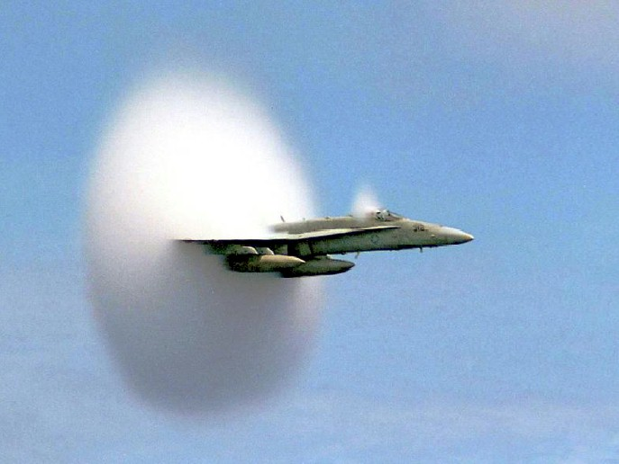
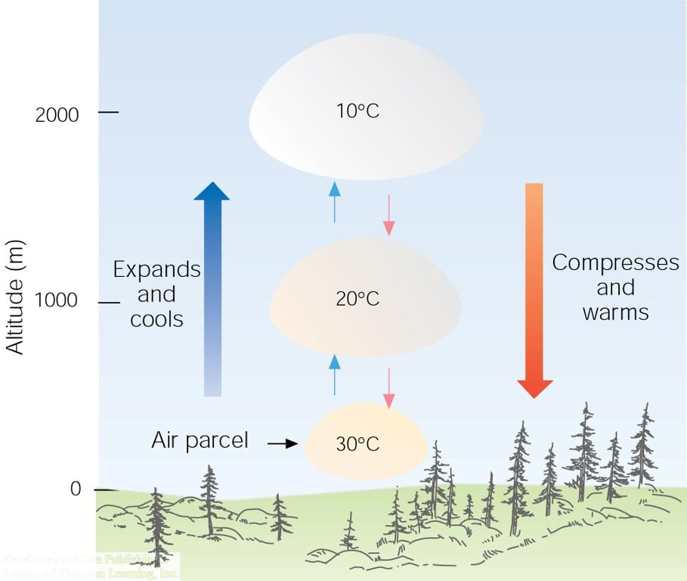

Slide 8
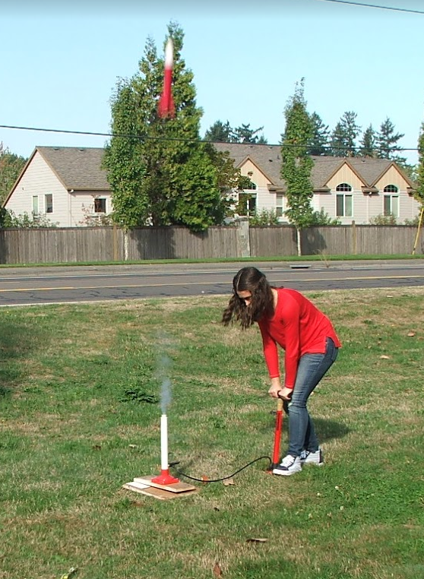

Slide 9
Adiabatic (no heat flow) processes
Pressure
Volume
Adiabatic compression: (Q = 0)
Work is done on the gas (-W)
No heat flows in: Q = ΔU + W
0 = ΔU + W, ΔU = -(-W)
Internal energy (T) rises
Examples
Bike pump/diesels
Hot side of fridge
Compressors
Demo – Fire plunger

Slide 10
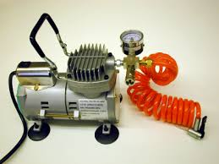
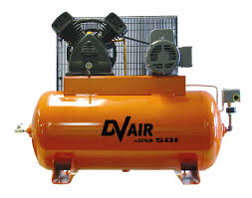
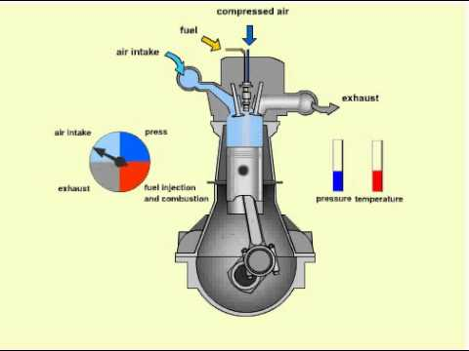

Slide 11
Isothermal (constant temperature) processes
Pressure
Volume
Isothermal expansion: (ΔT = 0)
Work is done by the gas (+W)
Internal energy is constant (ΔU = 0)
Q = ΔU + W = W
Heat turns to work (slowly)

Slide 12
Isothermal (constant temperature) processes
Pressure
Volume
Isothermal compression: (ΔT = 0)
Work is done on the gas (-W)
Internal energy is constant (ΔU = 0)
Q = ΔU + W = W
Work turns to heat (slowly)

Slide 13
What’s goin’ on here?
Pressure
Volume
isobaric expansion
heat flows in, temp increases

Slide 14
What’s goin’ on here?
Pressure
Volume
isochoric cooling
heat flows out, pressure drops

Slide 15
What’s goin’ on here?
Pressure
Volume
isochoric heating, isobaric expansion

Slide 16
Which process is adiabatic, which is isothermal?
Pressure
A
B
Volume
In which process would the temperature drop?
B is adiabatic

Slide 17
Which process is adiabatic, which is isothermal?
B
Pressure
A
Volume
In which process would the temperature increase?
B is adiabatic

Slide 18
A complete cycle:
B
C
Pressure
A
D
Volume
Complete cycle - where is work done?
Is more work done by gas or on the gas?

