Slide 1
Work pressure and volume
Contents:
Basic Concept
Example
Whiteboards
PV Whiteboards
Cycles
Whiteboards

Slide 2
Figuring out work:
The piston moves out a distance s:
P = ^{F}/_{A}, F = PA
W = Fs = PAs = PΔV
W = PΔV
W = work done by gas
P = pressure of gas
ΔV = change in volume of gas
Example: What work done by an isobaric compression at 500 Pa from .85 m³ to .52 m³?
s

Slide 3
Work, pressure and change in volume
1 | 2

Slide 4
Hugo First has a gas in a cylinder that expands from 200. liters to 500. liters at a pressure of 1200 Pa. What work did the gas do? (1000 liters = 1 m³)
W = PΔV
P = 1200 Pa, ΔV = .500-.200 = .300
W = 360 J
360 J

Slide 5
Mr. Fyde compresses a cylinder from .0350 m³ to .0210 m³, and does 875 J of work. What was the average pressure?
W = PΔV
W = -875, ΔV = .0350 - .0210 = -.0140 m³
P = 62500 Pa
62.5 kPa

Slide 6
How much work done by process EF?
500 Pa
E
F
P
V
.5 m³
W = PΔV, p= 200 Pa, ΔV = .8 - .2 = .6 m³
W = 120 J (work done by the gas)
120 J

Slide 7
How much work done by process BA?
500 Pa
A
B
P
V
.5 m³
W = PΔV, P = 300 Pa, ΔV = .1 - .4 = -.3 m³
W = -90 J (work done on the gas)
-90. J

Slide 8
How much work done by process CD?
500 Pa
D
C
P
V
.5 m³
W = PΔV, P_{avg} = 350 Pa, ΔV = .8 - .2 = .6 m³
W = 210 J (work done by the gas)
210 J

Slide 9
How much work done by process CD?
500 Pa
D
C
P
V
.5 m³
W = PΔV, p = 350 Pa, ΔV =0 m³
W = 0 J
waddayathink?

Slide 10
Example: Total work done by process ABCDA?
B
C
500 Pa
A
D
P
V
.5 m³
AB, CD: ΔW = 0, BC = (500 Pa)(+.5 m³) = +250 J,
DA = (200 Pa)(-.5 m³) = -100 J, W = 0+250+0+-100 = 150 J

Slide 11
Example: Total work done by process ABCDA?
B
C
500 Pa
A
D
P
V
.5 m³
Work = Area within A = LxW = (.5 m³)(300) = 150 net J
CW is positive work, ACW is negative work

Slide 12
How much net work done by this cycle?
500 Pa
P
V
.5 m³
W = Area = LxW = (.3 m³)(100 Pa) = +30 J (CW)
+30 J

Slide 13
How much net work done by this cycle?
500 Pa
P
V
.5 m³
W = Area = LxW = (.3 m³)(400 Pa) = -120 J (ACW)
-120 J

Slide 14
How much net work done by THIS cycle?
500 Pa
P
V
.5 m³
W = Area = ¹/₂bh = ¹/₂ (.3 m³)(300 Pa) = +45 J (CW)
+45 J

Slide 15
How much net work done by this cycle?
500 Pa
P
V
.5 m³
W = Area = Lxh = (.6 m³)(300 Pa) = -180 J (ACW)
-180 J

Slide 16
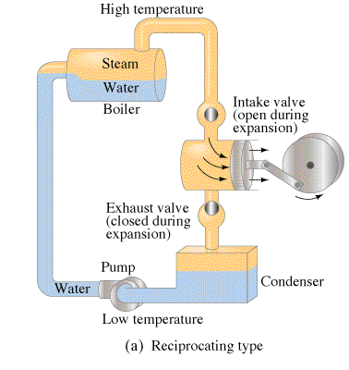
Heat engines
Turn heat to work
Demo - The little engine that could (explode)

Slide 17
Energy Flow
c
c
All heat engines waste a bit of heat

