Slide 1
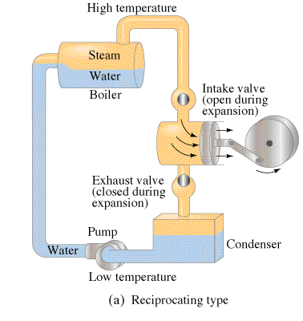
Heat Engines
Contents:
Basic Concept
Carnot cycle
Energy flow
Solving problems
Whiteboards
Heat Pumps
Whiteboard

Slide 2
Heat engines
Turn heat to work
Demo - The little engine that could (explode)
TOC

Slide 3
Energy Flow
Q_{h} - Heat that flows from boiler
T_{h} - Temperature K of boiler
W - Work done by engine
Q_{c} - Heat that flows to condenser
T_{c} - Temperature K of condenser
c
c
Q_{h} = Q_{c} + W
TOC

Slide 4
Energy Flow in heat engines
1 | 2 | 3
TOC

Slide 5
Gotelit Andamantan has a heat engine that uses 85 J of heat from the boiler, and wastes 60. J of heat. What amount of work does the engine do?
Q_{h} = Q_{c} + W,
Q_{h} = 85 J, Q_{c} = 60. J, W = ???
W
25 J

Slide 6
Ms Ribble has a steam engine that puts out work at a rate of 742 W, and consumes heat from the boiler at a rate of 995 W. At what rate does heat flow to the condenser? (Wasted)
Q_{h} = Q_{c} + W,
Q_{h} = 995 J, Q_{c} = ???, W = 742 W
Treat Watts the same as work, only it is a rate of work (J/s)
W
253 W

Slide 7
Mr. Meaner’s heat engine wastes 23 J of heat, and does 34 J of work, what heat must flow from the boiler?
Q_{h} = Q_{c} + W,
Q_{h} = ??? J, Q_{c} = 23 J, W = 34 J
W
57 J

Slide 8
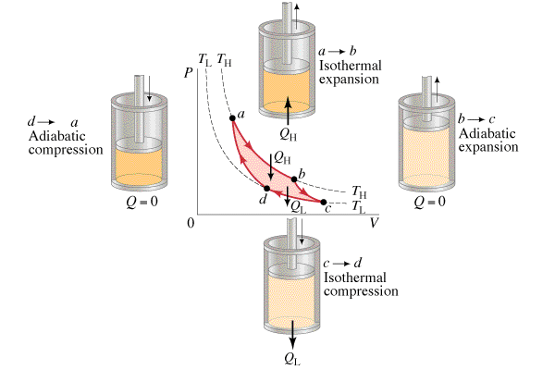
Carnot Cycle
Maximum efficiency possible
TOC

Slide 9
Efficiency
efficiency = What you want
What you paid
0 < efficiency < 1
efficiency = W = Q_{h} - Q_{c}
Q_{h} Q_{h}
efficiency = T_{h} - T_{c}
T_{h (Carnot cycle)}
Finally:
Q_{h} = Q_{c}
T_{h} = T_{c (Carnot cycle)}
c
c
TOC

Slide 10
Efficiency
efficiency = Q_{h} - Q_{c}
Q_{h}
efficiency = T_{h} - T_{c}
T_{h (Carnot cycle)}
Q_{h} = Q_{c}
T_{h} = T_{c (Carnot cycle)}
c
c
Example: A heat engine operates
at its Carnot efficiency. (i.e. it Carnot be more efficient) between the temperatures of 415 ºC and 303 ºC, doing work at a rate of 320 W. What is its efficiency, at what rate does heat flow from the boiler, and at what rate is heat wasted?
TOC

Slide 11
Carnot efficiency
1 | 2 | 3 | 4
TOC

Slide 12
Amanda Huggenkis operates a Sterling engine between the temperatures of 35 ºC and 13 ºC. What is the maximum theoretical efficiency she can achieve? (Assume Carnot efficiency)
efficiency = T_{h} - T_{c}
T_{h (Carnot cycle)}
T_{h} = 35 + 273 K, T_{c} = 13 + 273 K, efficiency = ???
efficiency = .0714 or 7.14%
W
.0714 or 7.14%

Slide 13
Amanda Huggenkis operates a Sterling engine between the temperatures of 35 ºC and 13 ºC. If the engine is to do 134 J of work, what heat must flow from the high temperature, and what heat is wasted?
Hint - we already know that efficiency = .071429
efficiency = Q_{h} - Q_{c}
Q_{h}
Q_{h} - Q_{c} = W = 134 J, Q_{c} = ???, Q_{h} = ???, efficiency = .071429
Q_{h} = 1876 J, 1876 - 134 = Q_{c} = 1742 J
W
1876 J, and 1742 is wasted

Slide 14
Kahn and Stan Tinople have a heat engine with a Carnot efficiency of .35, if the low temperature is 285 K, what must be the high temperature? (Assume Carnot efficiency)
efficiency = T_{h} - T_{c}
T_{h (Carnot cycle)}
T_{h} = ??, T_{c} = 285 K, efficiency = .35
T_{h} = 438 K = 440 K
W
440 K

Slide 15
Olive Hughe has a heat engine that does 25 J of work, and wastes 41 J of heat during a cycle. If the low temperature is 20. ºC, what must be the high temperature? (Assume Carnot efficiency)
Q_{h} = Q_{c}
T_{h} = T_{c (Carnot cycle)}
Q_{h} = 25 + 41 J, Q_{c} = 41 J, T_{c} = 273 + 20 K, T_{h} = ???
T_{h} = 472 K = 199 ºC
W
472 K or 199 ºC

Slide 16
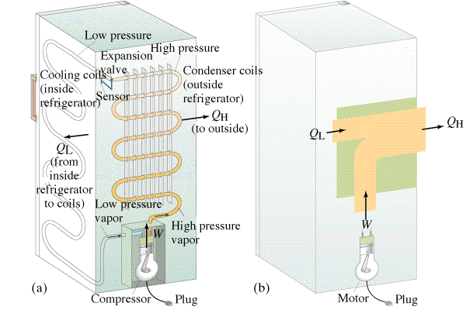
Heat Pumps
TOC

Slide 17
Heat Pumps
efficiency = Q_{h} - Q_{c}
Q_{h}
efficiency = T_{h} - T_{c}
T_{h (Carnot cycle)}
Q_{h} = Q_{c}
T_{h} = T_{c (Carnot cycle)}
Example: A refrigerator has a
temperature of -21 ºC in its ice box, and operates in a room where the temperature is 28 ºC. What work does the compressor need to do to make 100. J flow from the ice box to the room? (assume Carnot efficiency)
TOC

Slide 18
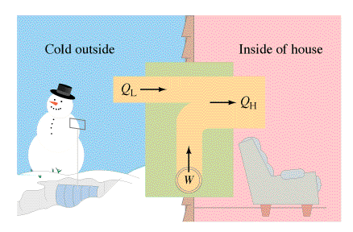
Heat Pumps
Does a heat pump really have an efficiency more than 1?
TOC

Slide 19
Heat Pumps
1| 2
TOC

Slide 20
Eliza Lott has an air conditioner that operates between the temperature of 18 ºC (inside the house) and 35 ºC (outside the house). If the air conditioner pumps 1200. J of heat outside, how much work did it do, and how much heat was removed from the house? (assume Carnot efficiency)
Q_{h} = Q_{c}
T_{h} = T_{c (Carnot cycle)}
Q_{h} = 1200. J, Q_{c} = ??, T_{h} = 273 + 35 K, T_{h} = 273 + 18 K
Q_{c} = 1133.8 J = 1130 J, W = 1200. - 1133.8 = 66 J
fillin
W
66 J, 1130 J

Slide 21
Frank Le Spekin heats his house with a heat pump, the hot side of which is inside his house at 24 ºC, and the pump takes heat from outside which is at -12 ºC. Assuming the pump operates at 85% Carnot efficiency, what work does the pump do to bring 1500 J of heat into the house? (Multiply the Carnot eff. by 85%)
Carnot e = T_{h} - T_{c} = 24 - (-12) = .12121212
T_{h} (273+24)
efficiency = .85(.121212) = .10303 = W/Q_{h} = W/(1500 J)
W = 155 J
W
155 J

