Slide 1
Calorimetry
Contents:
Basic Concept
Example
Whiteboards
Bomb Calorimeters

Slide 2
Calorimetry
Drop a hot piece of material into water
Heat lost by hot stuff = heat gained by cold stuff
TOC

Slide 3
Calorimetry - Example 1 - finding c
A .231 kg piece of unknown substance at 98 ºC is dropped into .481 kg of water at 18 ºC. The final temperature of the water is 32 ºC. What is the specific heat of the substance? (neglect the calorimeter cup, and assume no heat is lost to the surroundings) (c_{water} = 4186 JºC⁻¹kg⁻¹)
Heat lost = Heat gained
m₁c₁ΔT₁ = m₂c₂ΔT₂
(.231)c(98-32) = (.481 kg)(4186)(32-18)
c = 1848.9 = 1800 JºC⁻¹kg⁻¹
TOC

Slide 4
Calorimetry - find c or m
1 | 2
TOC

Slide 5
.112 kg of a mystery substance at 85.45 ºC is dropped into .873 kg of water at 18.05 ºC in an insulated Styrofoam container. The water and substance come to equilibrium at 23.12 ºC. What is the c of the substance?
(c_{water} = 4186 JºC⁻¹kg⁻¹)
Heat lost = Heat gained
m₁c₁ΔT₁ = m₂c₂ΔT₂
(.112)c(85.45-23.12) = (.873 kg)(4186)(23.12-18.05)
c = 2650 JºC⁻¹kg⁻¹
W
2650 JºC⁻¹kg⁻¹

Slide 6
A chunk of Mippsalipsium at 68.1 ºC is dropped into .625 kg of water at 21.1 ºC in a .257 kg Aluminum calorimeter. The water, Aluminum, and Mippsalipsium come to equilibrium at 25.2 ºC. What is the mass of the Mippsalipsium?
(c_{water} = 4186 JºC⁻¹kg⁻¹, c_{Al} = 900. JºC⁻¹kg⁻¹, c_{Mi} = 2174 JºC⁻¹kg⁻¹)
Heat lost = Heat gained
m₁c₁ΔT₁ = m₂c₂ΔT₂ + m₃c₃ΔT₃
m(2174)(68.1-25.2) = (.625)(4186)(25.2-21.1) + (.257)(900.)(25.2-21.1)
m = .125 kg
W
.125 kg

Slide 7
Calorimetry - Example 2 - Finding T
A .250 kg piece of iron at 95.0 ºC is dropped into .512 kg of water at 18.0 ºC. What is the final equilibrium temperature? (neglect the calorimeter cup, and assume no heat is lost to the surroundings)
(c_{water} = 4186 JºC⁻¹kg⁻¹,c_{Fe} = 450. JºC⁻¹kg⁻¹)
Heat lost = Heat gained
m₁c₁ΔT₁ = m₂c₂ΔT₂
(.250)(450)(95-T) = (.512 kg)(4186)(T-18)
(explain how to set up equation)
(show how to do math)
T = 21.845 ºC = 21.8 ºC
TOC

Slide 8
Calorimetry - find T
1 | 2
TOC

Slide 9
52 grams of glass at 91.1 ºC is dropped into 154 g of water at 25.1 ºC in an insulated Styrofoam container. What will be the final equilibrium temperature if no heat is lost to the surroundings?
(c_{water} = 4186 JºC⁻¹kg⁻¹, c_{glass} = 840 JºC⁻¹kg⁻¹)
Heat lost = Heat gained
m₁c₁ΔT₁ = m₂c₂ΔT₂
(.052)(840)(91.1-T) = (.154 kg)(4186)(T-25.1)
T = 29 ºC
W
29 ºC

Slide 10
127 grams of copper at 99.5 ºC is dropped into 325 g of water at 23.6 ºC in a 562 g glass beaker. What will be the final equilibrium temperature if no heat is lost to the surroundings?
(c_{water} = 4186 JºC⁻¹kg⁻¹, c_{glass} = 840 JºC⁻¹kg⁻¹, c_{Cu} = 390 JºC⁻¹kg⁻¹)
Heat lost = Heat gained
m₁c₁ΔT₁ = m₂c₂ΔT₂ + m₃c₃ΔT₃
(.127)(390)(99.5-T) = (.325)(4186)(T-23.6) + (.562)(840)(T-23.6)
T = 25.6 ºC
W
25.6 ºC

Slide 11
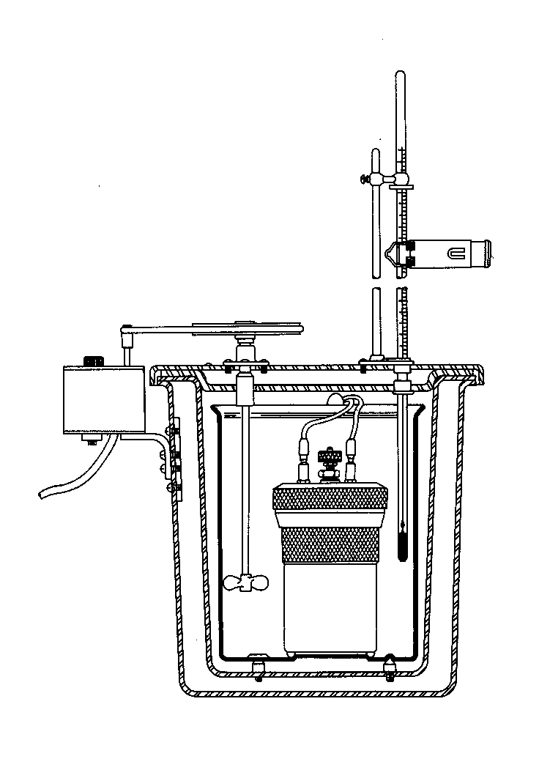
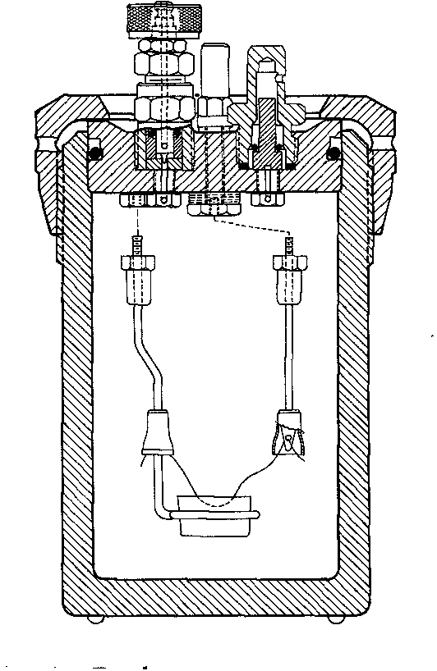
Bomb Calorimeters
The Bomb
The Bomb with water jacket
Candy bar/O₂/electric ignition/temperature rise
TOC
Notes:
The general procedure is to:
accurately measure a small amount of ester into the combustion capsule,
attach a weighed piece of iron fuse wire,
seal the sample in the bomb,
flush the bomb with O₂ and pressurize to 30 atm,
place the bomb into 2.000 L water at 24°C
record the water temperature at 30-second intervals for 5 minutes,
ignite the sample by passing electric current through the fuse,
record the water temperature at 30-second intervals for at least 20 minutes.
Finally, measure how much of the fuse wire was consumed (by mass difference), and whether there was any soot produced.

Slide 12
Bomb Calorimetry
1
TOC

Slide 13
3.215 g of a candy bar is placed in a 3.687 kg bomb calorimeter, surrounded by 2.150 kg of water. The entire apparatus is happily at 22.25 ºC before detonation, and the temperature rises to 33.12 ºC after. Ignore the heat retained by the combustion products.
A) What is the energy released to the calorimeter and water in kilojoules? (c_{water} = 4186 JºC⁻¹kg⁻¹, c_{Al} = 900. JºC⁻¹kg⁻¹)
B) What is the caloric content in Kilocalories (C) if the entire candy bar has a mass of 35 grams. 1 cal = 4.18 J
Heat released = m₁c₁ΔT₁ + m₂c₂ΔT₂
Heat = (3.687)(900.)(33.12-22.25) + (2.150)(4186)(33.12-22.25)
Heat = 136856.4523 J = 137 kJ
Total energy = 133.76*35/4.18/3.215 = 356 kc = 356 C
W
134 kJ, 348 C

