Slide 1
Caloric model (Bad)
Heat is a fluid (caloric)
Heating up a cup of coffee
Coffee on the counter

Slide 2
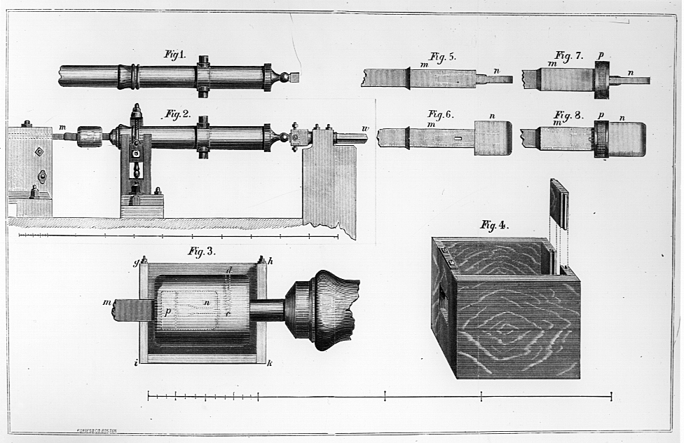
Count Rumford
Boring cannon barrels generated heat
Caloric release = getting finer
When the drill bits got dull…

Slide 3
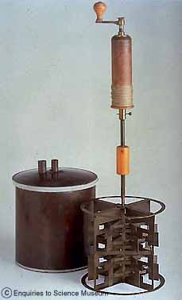
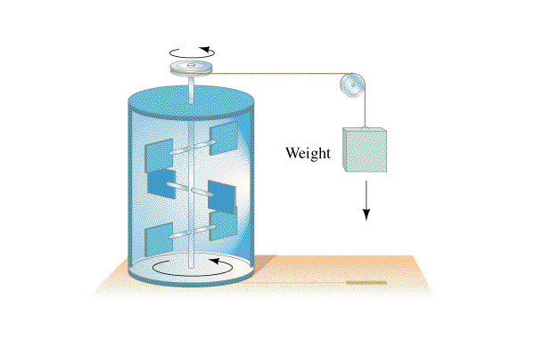
Joule’s Discovery
Falling mass heated water by stirring
Heat equivalent of work
1 Calorie = 4.186 J

