Slide 1
Refraction in 2 Dimensions
Contents:
Two dimensions
Whiteboard
Critical angle
Total internal reflection
Dispersion

Slide 2
Refraction in 2 dimensions
Light hitting slower medium:
Straight on = smaller wavelength
Big
λ
Small
λ

Slide 3
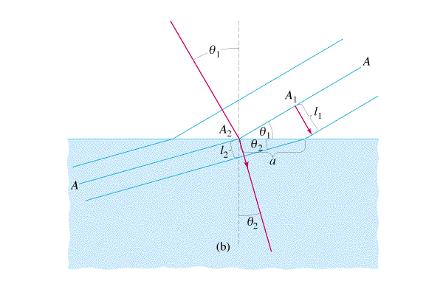
Refraction in 2 dimensions
Light hitting slower medium:
Hits at an angle = smaller wavelength, bends
Demo - laser

Slide 4
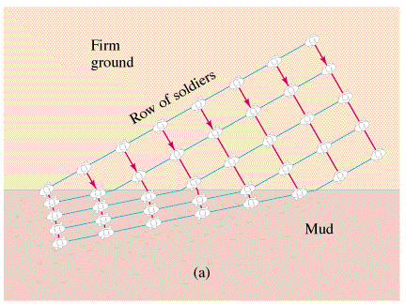
Refraction in 2 dimensions
Light hitting slower medium:
Hits at an angle = smaller wavelength, bends
steering a tractor
Danny’s Truck

Slide 6
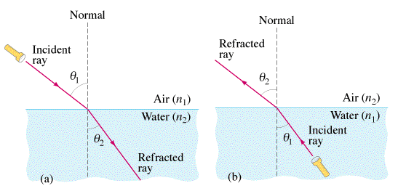
What happens as θ2 gets larger and larger in fig b????

Slide 7
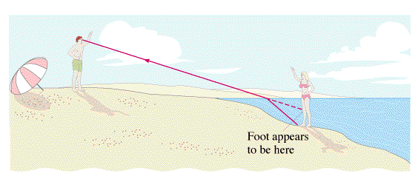

Slide 8
Refraction in 2 dimensions
Make a drawring…

Slide 9
Refraction in 2 dimensions
Deriving
v = fλ
n = c/v

Slide 10
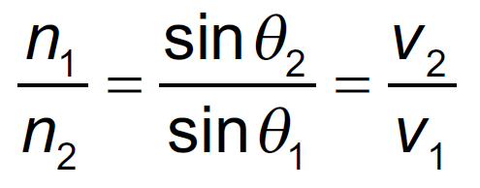
Refraction in 2 dimensions
n_{1,2} = index of refraction
θ_{1,2} = angle with perp
v_{1,2} = wave speed

Slide 11
Refraction in 2 dimensions
67º
n = 1.00
n = 1.51
???
A laser makes an angle of 67.0º with the perpendicular from air on a piece of Lucite with an index of refraction of 1.51. What is the refracted angle?
37.6º

Slide 12
Refraction in 2 dimensions
1-4

Slide 13
A beam of light makes an angle of 25º with the perpendicular on the air side of a liquid, and 17º below the liquid. What is the substance’s index of refraction?
n₁ sin θ₁ = n₂ sin θ₂
n₁ = 1.00, θ₁ = 25º, θ₂ = 17º
n = 1.00
25º
17º
n = ??
1.45

Slide 14
A ray of light has an incident angle of 12º with the underside of an air-water interface, what is the refracted angle in the air? (n = 1.33 for water, 1.00 for air)
??
n₁ sin θ₁ = n₂ sin θ₂
n₁ = 1.33, θ₁ = 12º, n₂ = 1.00
n = 1.00
n = 1.33
12º
16º

Slide 15
A ray of light has an incident angle of 48º with the underside of an air-water interface, what is the refracted angle in the air? (n = 1.33 for water, 1.00 for air)
??
n = 1.00
Try a 48º incident angle:
n = 1.33
48º
81º

Slide 16
A ray of light has an incident angle of 48.753º with the underside of an air-water interface, what is the refracted angle in the air? (n = 1.33 for water, 1.00 for air)
??
n = 1.00
Try a 48.753º incident angle:
n = 1.33
48.753º
89.8º

Slide 17
Critical Angle
From slow to fast
Light bends over. When θ_{fast} = 90º, light does not leave water - total internal reflection
Demo - fiber optic, light underwater

Slide 18
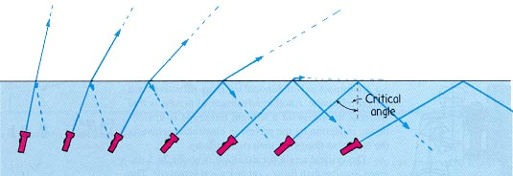

Slide 19
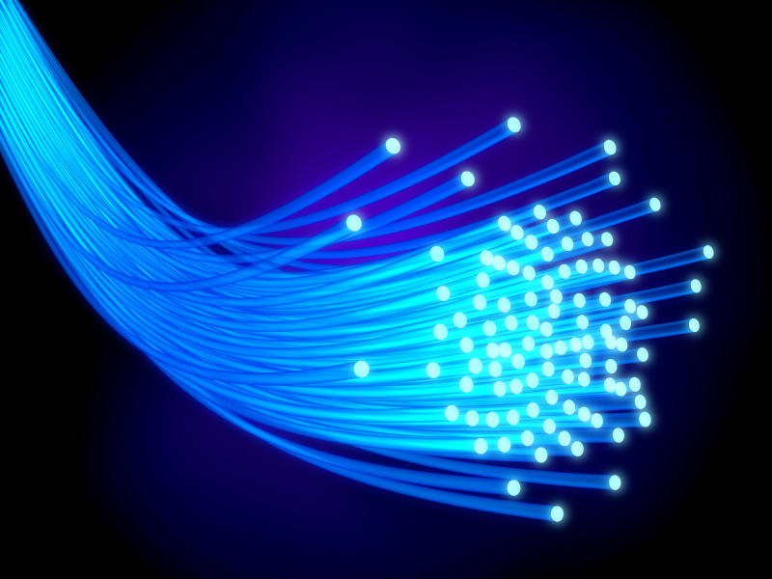

Slide 20
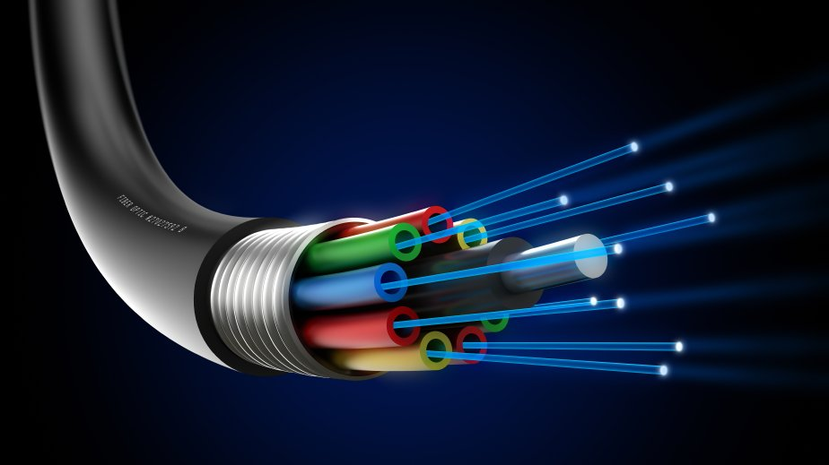

Slide 21
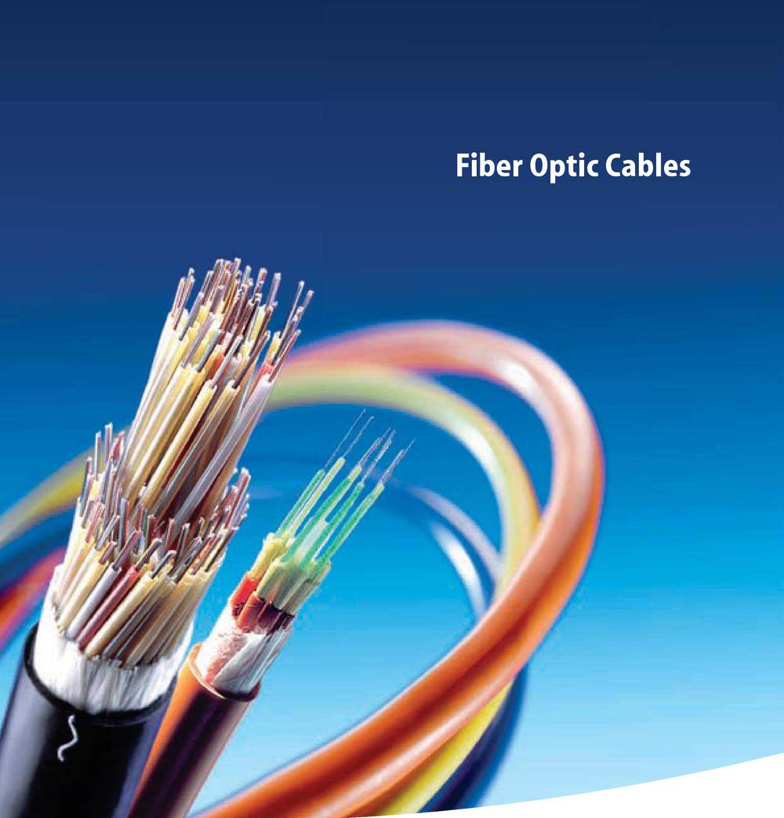

Slide 22
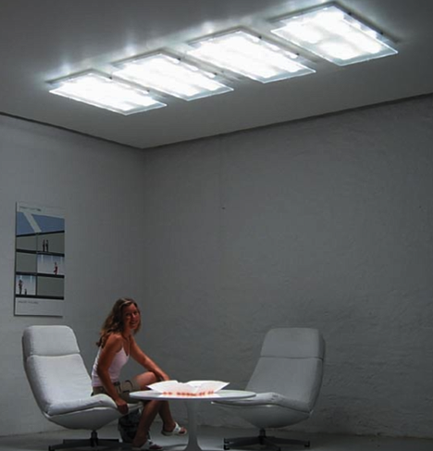
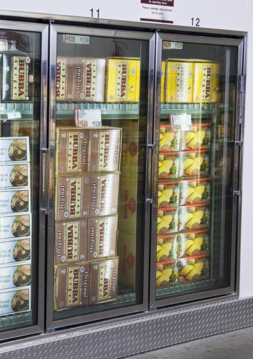

Slide 23
Example
What is the Critical angle for an air-water interface?
n = 1.00
θ_{c}
n = 1.33
n₁ sin θ₁ = n₂ sin θ₂
n₁ = 1.33, θ_{c} = ??, θ₂ = 90º, n₂ = 1.00
θ_{c} = sin⁻¹(1.00xsin(90º)/1.33)
48.8º

Slide 24
What is the Critical angle for an water-diamond interface? Where does the critical angle occur?
n = 1.33
n = 2.42
θ_{c}
n₁ sin θ₁ = n₂ sin θ₂
n₁ = 2.42, θ_{c} = ??, θ₂ = 90º, n₂ = 1.33
θ_{c} = sin⁻¹(1.33xsin(90º)/2.42)
33.3º in the diamond

Slide 27
What angle does a light ray that makes a 32º angle with the bottom surface of an air-water interface make with the top side when it is in the air? (n = 1.33 for water, 1.00 for air)
Tricky - is 32º the incident angle?
32º
n₁ sin θ₁ = n₂ sin θ₂
n₁ = 1.33, θ₁ = 90-32º, n₂ = 1.00
Yaakk??

