Slide 1
Q Factor –
Contents:
Concept of resonance
Damped Motion
Film
Demos

Slide 2
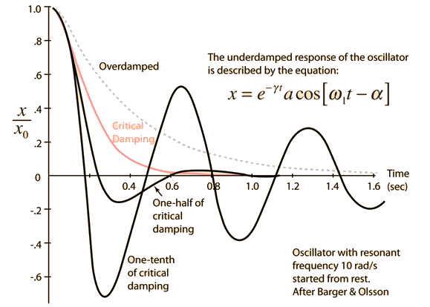

Slide 3
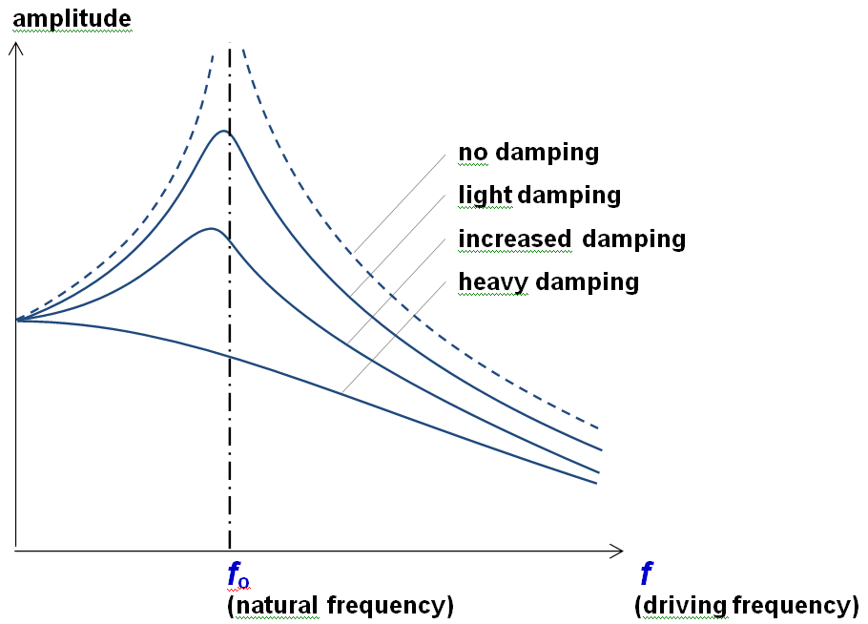

Slide 4
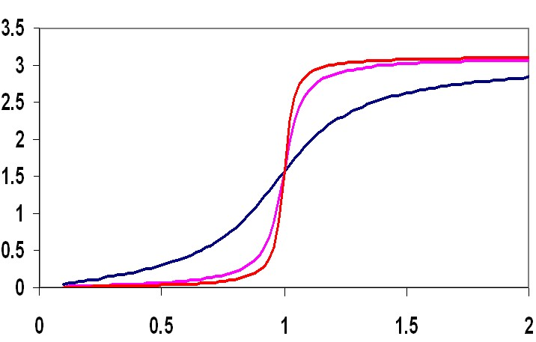

Slide 5
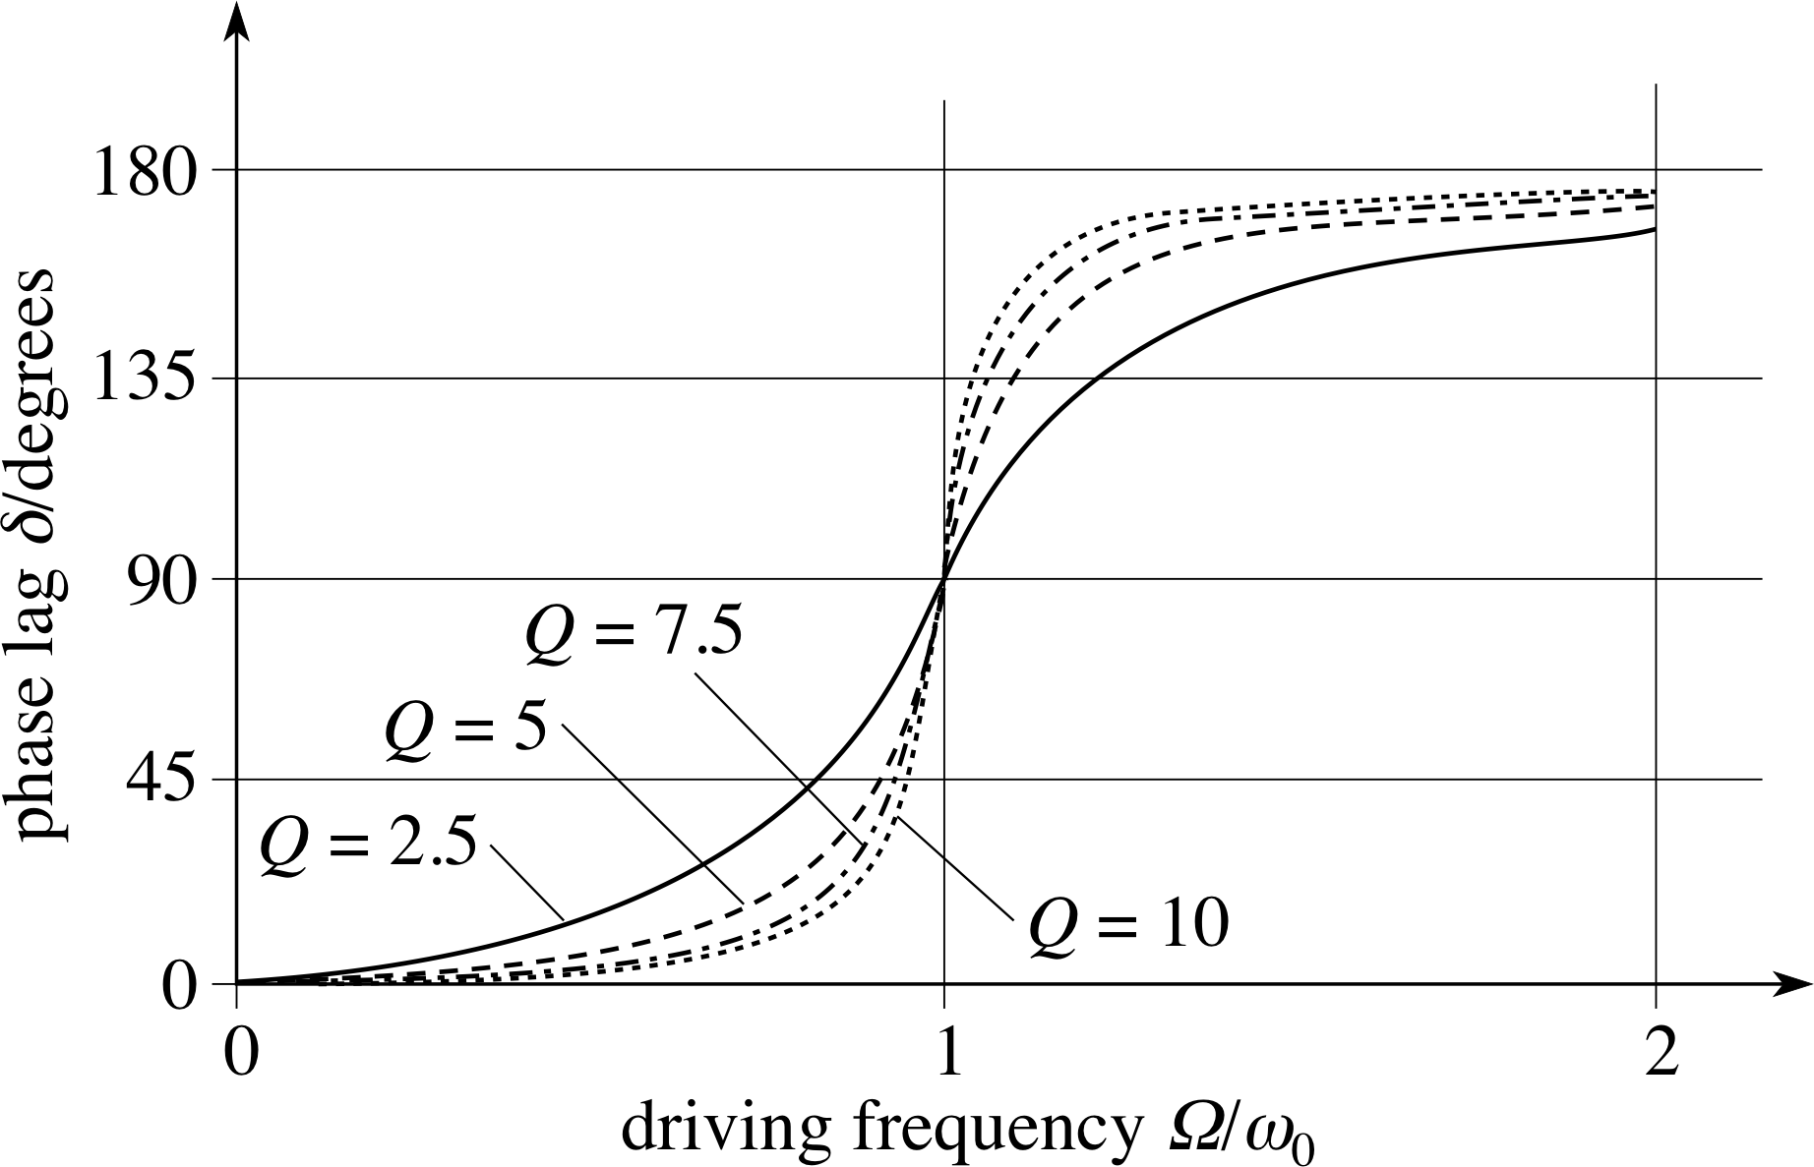

Slide 6
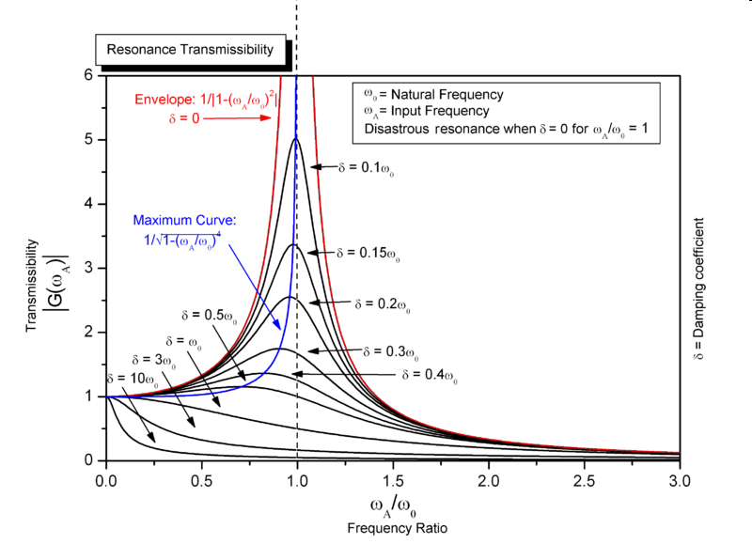
Resonance - Dynamics
x = x_{o}sin(ωt)
ω =
Show
Large mass/Small mass on spring (large mass oscillates slower)
Drive spring with different frequencies

Slide 7
A – Over damped
B – Critically damped
C – Under damped
Show
Mass on spring with rangefinder – 300 seconds
What shape is the envelope?

Slide 8
Q factors:
0.5 – critically damped
50+ – mass on a spring
Roughly how many cycles it will go before it stops
A – Over damped
B – Critically damped
C – Under damped

