Slide 1
Flow rate and Continuity
Contents:
How to calculate
Whiteboards

Slide 2
Incompressible, laminar flow:
Concept 0
Volume flow rate = Av
What is the volume flow rate of air moving at 1.30 m/s down a hallway that measures 3.20 m by 4.10 m? What time will it take to change the air in a room that measures 10.2 m x 14.0 m x 5.20 m?
17.1 m³/s, 43.5 s

Slide 3
Incompressible, laminar flow:
Continuity:
A₁v₁ = A₂v₂
A = Area (m²)
v = Velocity (m/s)
Derive
Demo (sink nozzle)
Mr. Rieck’s demonstration with a pipette…..
gasses…

Slide 4
Incompressible, laminar flow:
A₁v₁ = A₂v₂
A = Area (m²)
v = Velocity (m/s)
A 12.0 cm inner diameter pipe with water flowing at 1.18 m/s narrows to 5.00 cm inner diameter. What is the velocity in the narrow part? What is the volume flow rate in m³/s?
(6.80 m/s, 0.0133 m³/s)

Slide 5
Continuity
1 | 2 | 3

Slide 6
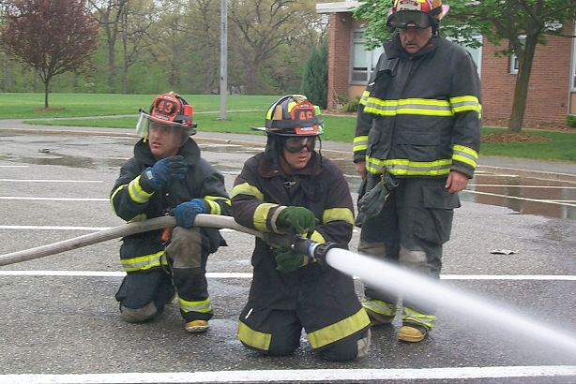
Water is going at 1.45 m/s down a fire hose with a 6.20 cm inner diameter. If the water leaves the hose at a speed of 17.3 m/s, what is the inner diameter of the nozzle?
https://www.youtube.com/watch?v=eHXve23fCZw
Fire hose gets away
1.79 cm

Slide 7
All the air going down a 3.0x4.0 m hallway goes through a doorway that measures 74 cm by 203 cm. If the air in the doorway is going 1.8 m/s, what is the speed of the air in the hallway?
0.23 m/s

Slide 8
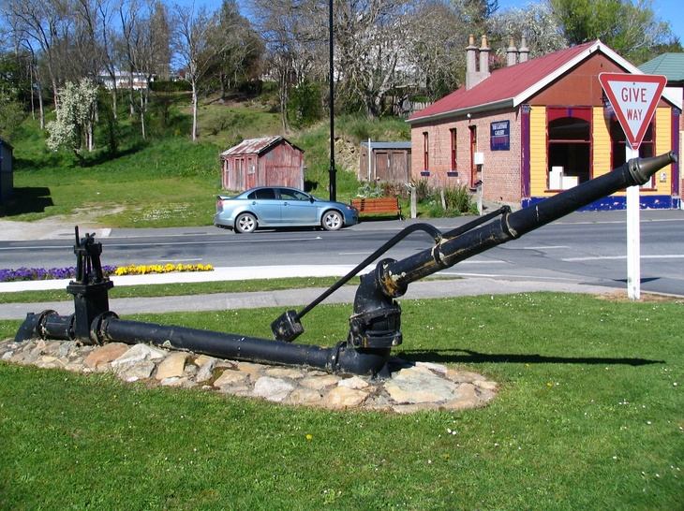
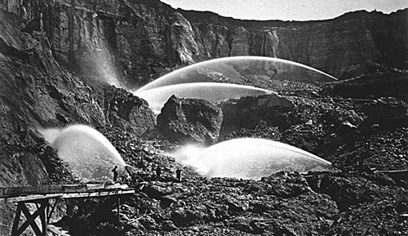
A hydraulicking monitor or giant discharges water at 44.0 m/s from a 3.0 cm diameter nozzle. What is the flow rate in m³/s, and what is the velocity in the 12 cm diameter supply pipe?
What recoil force does it exert?
0.031 m³/s, 2.75 m/s, 1400 N

