Slide 1
Viscosity
Contents:
How to calculate
Whiteboards

Slide 2
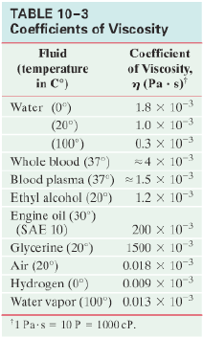
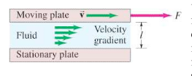
Definition of Viscosity
On what would the force depend?
F = Force needed to maintain velocity (N)
η = Viscosity in N s m⁻² or Pa s
A = Area of plates in m²
l = distance separating plates in m
v = velocity of the plates in m/s

Slide 3
Example
Some students are able to move a 40.0 cm x 20.0 cm float at a constnat speed of 0.170 m/s using an applied force of 0.408 N. What is the viscosity if the distance between the float and the bottom of the container is 5.00 cm?
float
fluid
F = ηAv/l, η = ???
0.408 N= η(0.4 m x0.2 m )(0.17 m/s)/(.05 m)
1.50 Pa s

Slide 4
Stokes’s Law – a small sphere moving through a fluid
F_{D} = Force needed to maintain velocity (N)
η = Viscosity in N s m⁻² or Pa s
r = radius of sphere in m
v = velocity of the sphere in m/s
Demo – spray/muddy water
not for large fast moving objects –
must be laminar flow around sphere
Smooth sphere…

Slide 5
Example
A droplet of water mist (ρ = 1000 kg m⁻³) has a radius of 4.8 microns. What is its terminal velocity as it falls through air
(η = 1.8x10⁻⁵ Pa s)? (ignore the buoyant force)
4/3πr³ρg = 6πηrv
v = 0.0027904 m/s
0.0028 m/s

Slide 6
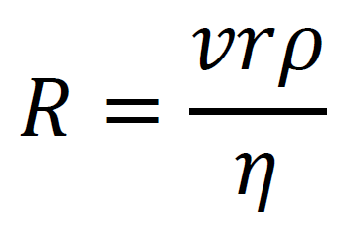
Reynolds number – fluid in a pipe
Inertial Forces
Viscous forces
R = Reynolds number (unitless!!!!)
η = Viscosity in N s m⁻² or Pa s
ρ = density of fluid in kg m⁻³
r = radius of object or pipe in m
v = velocity of the object relative to fluid in m/s
When viscous forces dominate = low R = Laminar
When inertia dominates = high R = Turbulent
Onset of turbulence 1000 – 2000
Fully turbulent: 10,000
Specify which R you are using based on the length you use. (this is Re_r, there can be many different Re)
Has to do with behaviour of fluid/regimes of behaviour.
https://www.youtube.com/watch?v=WG-YCpAGgQQ
https://www.youtube.com/watch?v=LOmQ-QLejCU
https://www.youtube.com/watch?v=IDeGDFZSYo8

Slide 7
Example
Water at 20.ºC (η = 1.0x10⁻³ Pa s, ρ = 1000. kg m⁻³) flows down an 8.0 mm diameter glass tube at 0.120 m/s. Calculate the Reynolds number to determine if the flow is laminar. What is the maximum velocity the water could have and still be laminar? (For sure… set R = 1000)
R = (0.120)(.0040)(1000)/(1.0x10⁻³) = 480 – so yes it is laminar
v = Rη/(ρr) = (1000) (1.0x10⁻³)/((1000)(.004)) = 0.25 m/s
480 – yes, 0.25 m/s

Slide 8
Viscosity
1-5

Slide 9
What force is needed to move a 0.85 cm diameter marble through Karo corn syrup at 1.00 cm/s? η = 2350 Pa s
6π(2350 Pa s)(.0085 m/2)(.01 m/s) = 1.8826 N
1.9 N

Slide 10
A water droplet has a terminal velocity of 0.00350 m/s falling through air. What is its radius? (ignore the buoyant force)
Water: ρ = 1000. kg m⁻³
Air: η = 1.81x10⁻⁵ Pa s
4/3πr³ρg = 6πηrv
5.39 microns

Slide 11
What would be the terminal velocity of a 8.20 μm diameter piece of basalt silt (ρ = 2920 kg m⁻³) sinking in water with a density of 1025 kg m⁻³ and a viscosity of 1.72x10⁻³ Pa s. (You can’t ignore the buoyant force on the particle) What time would it take in minutes and seconds to settle in a test tube that is 5.40 cm tall?
4.04x10⁻⁵ m/s, 22 minutes 17 s – demo centrifuge

Slide 12
What is the Reynolds number for a ping pong ball going through the air at 5.10 m/s? Use r = 0.0200 m. Is the flow around it laminar? (R<1000)
ρ = 1.29 kg m⁻³
η = 1.81x10⁻⁵ Pa s
R = (12.0)(.0200)(1.29)/(1.81E-5) = 7269.6
7270 – so no

Slide 13
What is the maximum speed air could move down a 12.2 cm diameter duct and have laminar flow? (R < 1000)
ρ = 1.29 kg m⁻³
η = 1.81x10⁻⁵ Pa s
v = (1000)(1.81E-5)/{(.061)(1.29)}
0.230 m/s

Slide 15
Example
Problem 50: (II) A viscometer consists of two concentric cylinders, 10.20 cm and 10.60 cm in diameter. A particular liquid fills the space between them to a depth of 12.0 cm. The outer cylinder is fixed, and a torque of 0.024 mN keeps the inner cylinder turning at a steady rotational speed of 62.0 rev/min. What is the viscosity of the liquid?
F = ηAv/l, η = ???
F = Γ/r = (0.024 mN)/(.051 m) = 0.470588 N
A = (2πr)h = (2π(0.051))(0.12m) = 0.038453 m²
v = ωr = {(62x2xπ rad)/(60 sec)}(0.051 m) = 0.3311 m/s
l = (10.60 cm – 10.20 cm)/2 = 0.20 cm = 2.0E-3 m
η = Fl/(Av) = 0.0739178 Pa s
0.0739 Pa s

