Slide 1
Pascal’s Principle
Contents:
How to calculate
Whiteboards

Slide 2
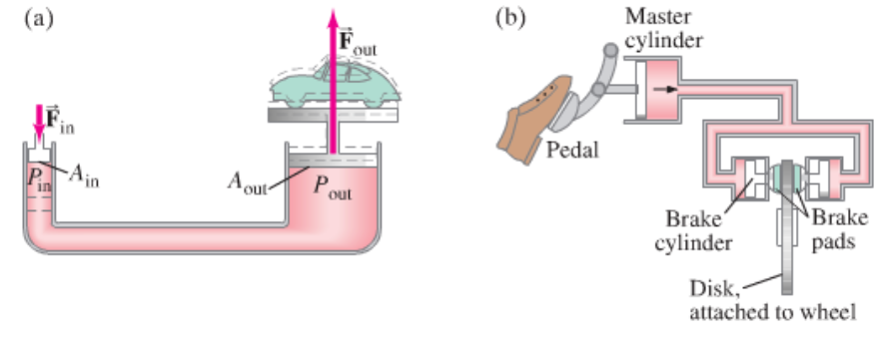
A confined fluid transmits external pressure:
Demo - hydraulic jack

Slide 3
Example – A hydraulic jack has an input piston with a diameter of 8.20 mm, and an output piston diameter of 95.0 mm. What force in Newtons do you need to apply to lift a ton? (8900 N) What is the pressure in Pa? How far must you move the input cylinder to raise the car 10.0 cm?
(66.3 N, 1.25E6 Pa, 1340 cm)

Slide 4
Pascal’s Principle
1 | 2 | 3

Slide 5
A car has a master cylinder bore size of 2.50 cm, and a caliper bore of 4.40 cm. What force does the caliper exert if you press on the master cylinder with a force of 150 N?
(150 N)/(π(.044/2)²) = F/(π(.025/2)²)
F = 150(4.4²/2.5²) = 464.64 N
465 N

Slide 6
A hydraulic jack has an output cylinder with a 5.2 cm bore, and needs to lift a 53,400 N weight with an input force of 356 N. What is the diameter of the input cylinder needed?
(53,400)/(π(.052/2)²) = (356)/(π(D/2)²)
0.0042 m or 0.42 cm

