Slide 1
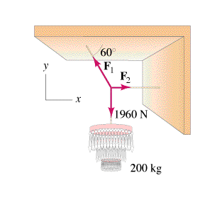
Statics: Equilibrant
The condition of equilibrium
How to solve
Example
Whiteboards
(Demo: Force scales, masses)

Slide 2
Statics – acceleration = 0
Force Equilibrium - <The sum of all forces > = 0
F₂
Adding the three forces tip to tail:
F₃
F₁
They add to zero

Slide 3
The Equilibrant is the opposite of the sum.
Add the given vectors
Negate the sum
Find its magnitude
Find some angle
Draw and label it

Slide 4
y
B = 14 N
A = 23 N
56º
29º
Example:
x
θ
Find F, and θ such that the system will be in equilibrium
(This force is called the equilibrant)
F
x y
A
B
F
Sum 0 0
W

Slide 5
y
B = 14 N
A = 23 N
56º
29º
Example:
x
θ
Find F, and θ such that the system will be in equilibrium
(This force is called the equilibrant)
F
x y
A 20.12 11.15
B -7.83 11.61
F
Sum 0 0
W

Slide 6
y
B = 14 N
A = 23 N
56º
29º
Example:
x
θ
Find F, and θ such that the system will be in equilibrium
(This force is called the equilibrant)
F
x y
A 20.12 11.15
B -7.83 11.61
F -12.29 -22.76
Sum 0 0
W

Slide 7
y
B = 14 N
A = 23 N
56º
29º
Example:
x
θ
-22.76
F
θ
Mag = √(22.76²+12.29²) ≈ 26 N
θ = Atan(22.76/12.29) ≈ 62º
Trig angle = 180+62 = 242º
-12.29
x y
A 20.12 11.15
B -7.83 11.61
F -12.29 -22.76
Sum 0 0
W

Slide 8
Whiteboards:
Equilibrant
1 | 2
TOC

Slide 9
Find the equilibrant for the forces indicated. Express as a magnitude and a trig angle
y
A = 15.0 N
θ
23.0º
x
x y
A 13.81 5.86
B -23.42 -26.01
Equil. 9.61 20.15
Sum 0 0
42.0º
B = 35.0 N
Mag = √(9.61²+20.15²) ≈ 22.32 N
θ = Atan(20.15/9.61) ≈ 64.50º
W
22.3 N at 64.5º

Slide 10
Find the equilibrant for the forces indicated. Express as a magnitude and a trig angle
y
A = 18.0 N
17.0º
θ
x
28.0º
x y
A 5.26 17.21
B -25.61 -13.61
C 2.49 -11.74
Equil 17.85 8.14
Sum 0 0
B = 29.0 N
12.0º
C = 12.0 N
Mag = √(17.85²+8.14²) ≈ 19.6 N
θ = Atan(8.14/17.85) ≈ 24.5º
W
19.6 N at 24.5º

