Slide 1
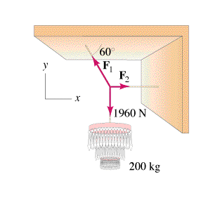
How to solve:
Net force in the x dir. = 0
Net force in the y dir. = 0
Step By Step:
Draw Picture with forces as arrows
Calculate weights (?)
Express/calculate components (SOH CAH TOA)
Set up a <sum of all forces> = 0 equation for x and another for the y direction
Do math.

Slide 2
