Slide 1
Angular Mechanics - Coriolis Effect
Contents:
Concept 1
Concept 2
The Earth

Slide 2
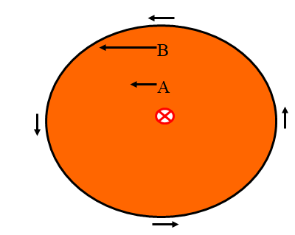
Consider a spinning Merry-Go Round with two riders, A and B
Concept 1
B has a greater tangential velocity than A because of the tangential relationship
v = ωr

Slide 3
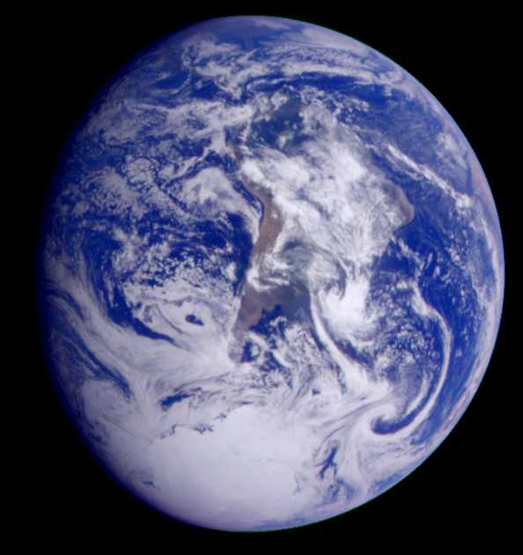
The Earth is also a rotating frame of reference:

