Slide 1
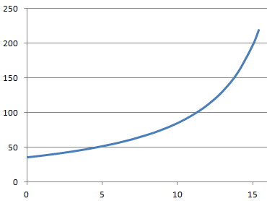
A rocket taking off from earth has a mass of 100. kg, 80.0 kg of which is fuel. It burns fuel at a rate of 5.20 kg/s with an exhaust velocity of 875 m/s.
1. What is the thrust of the engine? (4550 N)
2. What is the initial and final mass of the rocket? (100. kg and 20. kg)
3. For what time does the engine burn? (15.4 s)
4. What are the initial and final accelerations of the rocket?
(don’t forget gravity) (35.7 m/s/s, 218 m/s/s)
For the TAG kids only:
5. What is the acceleration at t = 12.0 s into the burn? (111.2 m/s/s)
6. Graph the acceleration with your calculator.

