Slide 1
Quizlette 6.2

Slide 4
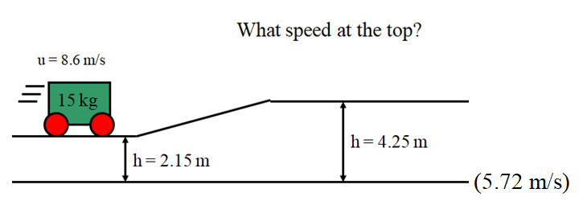

Slide 5
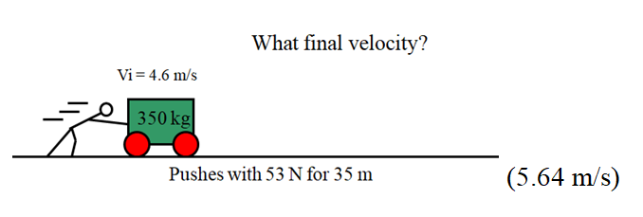

Slide 9
