Slide 1
Formative Assessment

Slide 2
1. What is the force of gravity between the Philae probe with a mass of 100. kg and comet 67P with a mass of 1.05x10¹³ kg if the probe is resting on the surface of the 2.05 km radius comet. (That we will pretend is spherical - it's highly not) ( 0.0167 N )

Slide 3
2. What distance needs to separate the centers of two 5.20 kg spheres so that the force of gravity between them is 1.20x10⁻⁹ N (1.23 m )

Slide 4
3. Your 12,500 kg spaceship is orbiting 1.16x10⁷ m from the center of a planet every 17,500 s. What is the mass of the planet? (3.02x10²⁴ kg)

Slide 5
4. At what distance from the center of our 7.35x10²² kg moon is the orbital velocity 340. m/s? (4.24x10⁷ m)

Slide 6
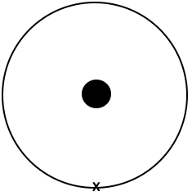
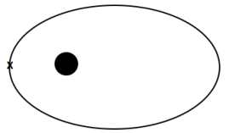
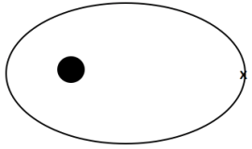
5. Draw the new orbit: (Circle or oval indicates your current orbit)
Slow at x: Speed up at x: Speed up at x:

Slide 8
1. a. What is the force of gravity between a 6.50x10¹⁶ kg asteroid and a 18,700 kg spaceship if their centers are 1,450 m distant?
38,600 N

Slide 9
b. The centers of two lead spheres are separated by 6.70 m. If one sphere has a mass of 56.0 kg, and there is an attractive force of 3.70x10⁻⁹ N, what is the mass of the other sphere?
44.5 kg

Slide 10
c. You are orbiting the planet Qwrmczl at a radius of 1.45x10⁷ m, at a velocity of 3410 m/s. What is its mass?
2.53x10²⁴ kg

Slide 11
d. What is the period of an orbit that is 3.90x10⁸ m from earth's center? (m = 5.97x10²⁴ kg)
2.43x10⁶ s

Slide 13
2. a. What is the force of gravity between a 2.60x10¹³ kg asteroid and a 56,100 kg spaceship if their centers are 3,560 m distant?
7.68 N

Slide 14
b. What distance separates the centers of two lead spheres if one has a mass of 123 kg, the other a mass of 12.0 kg and there is an attractive force of 3.20x10⁻¹² N?
175 m

Slide 15
c. You are orbiting the planet Wnnydrydrl at a radius of 7.80x10⁶ m, and a period of 2.30x10⁴ seconds. What is the planet’s mass?
5.31x10²³ kg

Slide 16
d. What is the radius of an orbit around earth (m = 5.97x10²⁴ kg) that has an orbital velocity of 27.2 m/s?
5.38x10¹¹ m

Slide 18
question
answer

Slide 19
question
answer

