Slide 1
Example 0 – A physics teacher twirls a bucket of water in a 1.12 m radius vertical circle. What is the minimum velocity at the top of the circle that will keep the water in the bucket?

Slide 2
Example 1 – A Ferris wheel "pulls" 0.15 "g"s. What "g" force do they feel at the top and bottom?

Slide 3
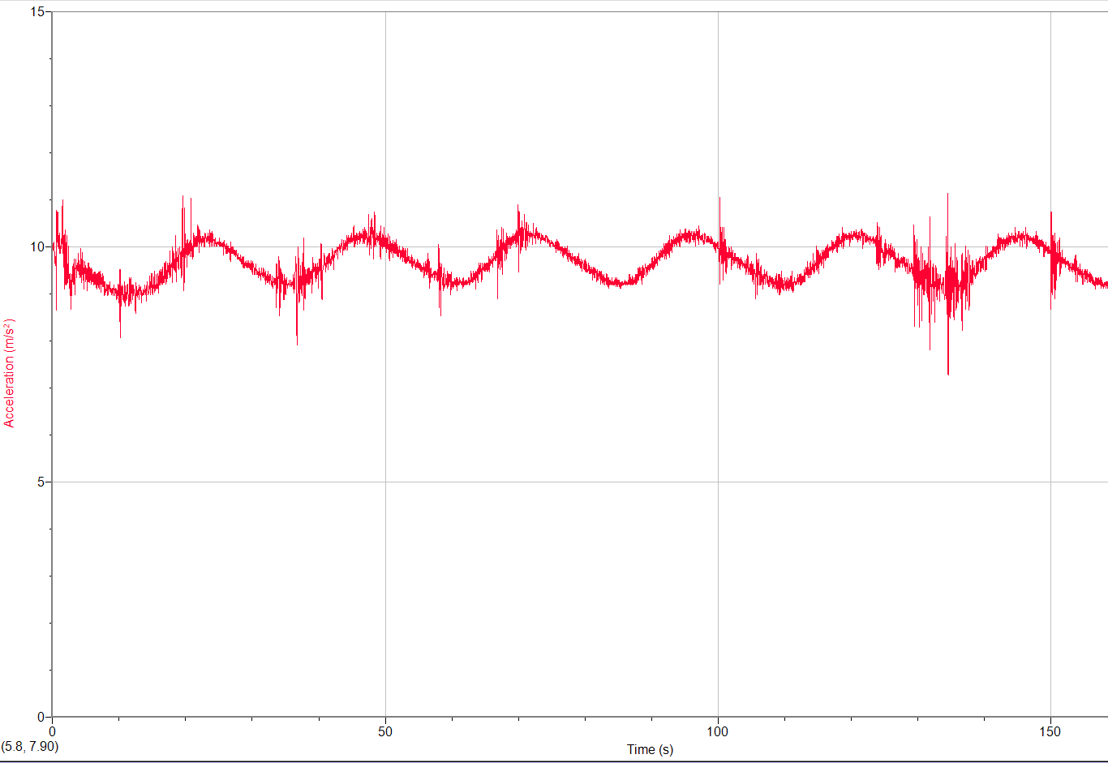

Slide 4
Example 2 – A rider moving in a 3.75 m radius vertical circle feels 0.80 “g”s inverted at the top of the circle.
A) How many “g”s is the ride pulling?
B) How many “g”s do they feel at the bottom?

Slide 5
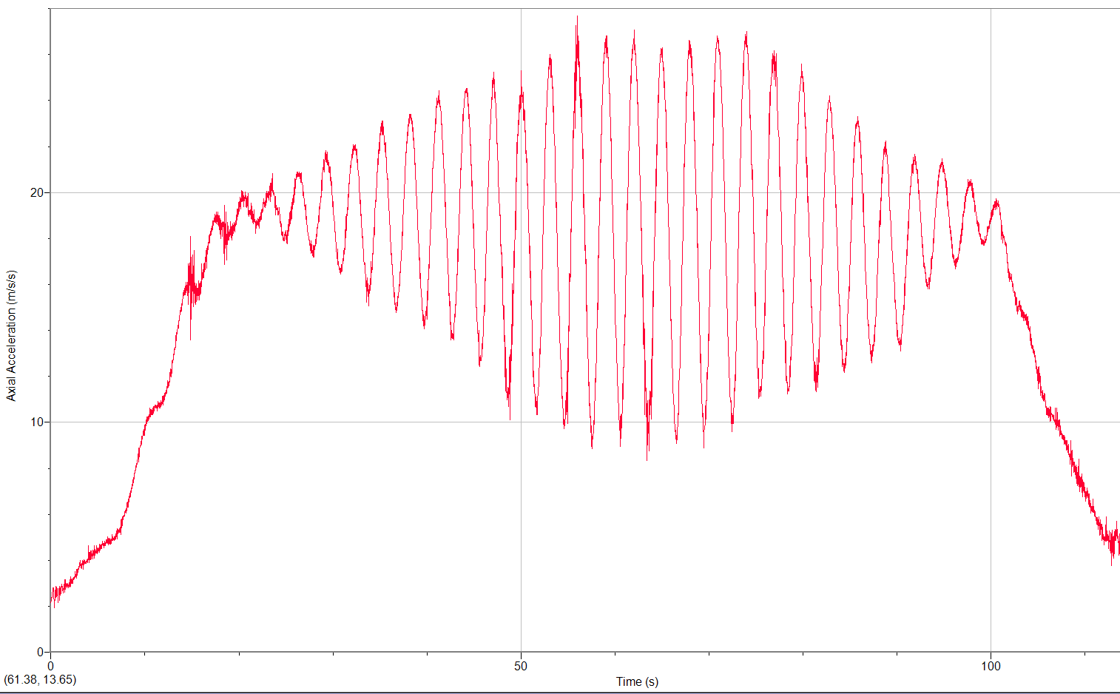

Slide 6
Example 3 – On the Rock-O-Plane a rider feels 1.62 "g"s at the bottom of the ride. What is the ride actually pulling, and what "g" force will they feel at the top?

Slide 7
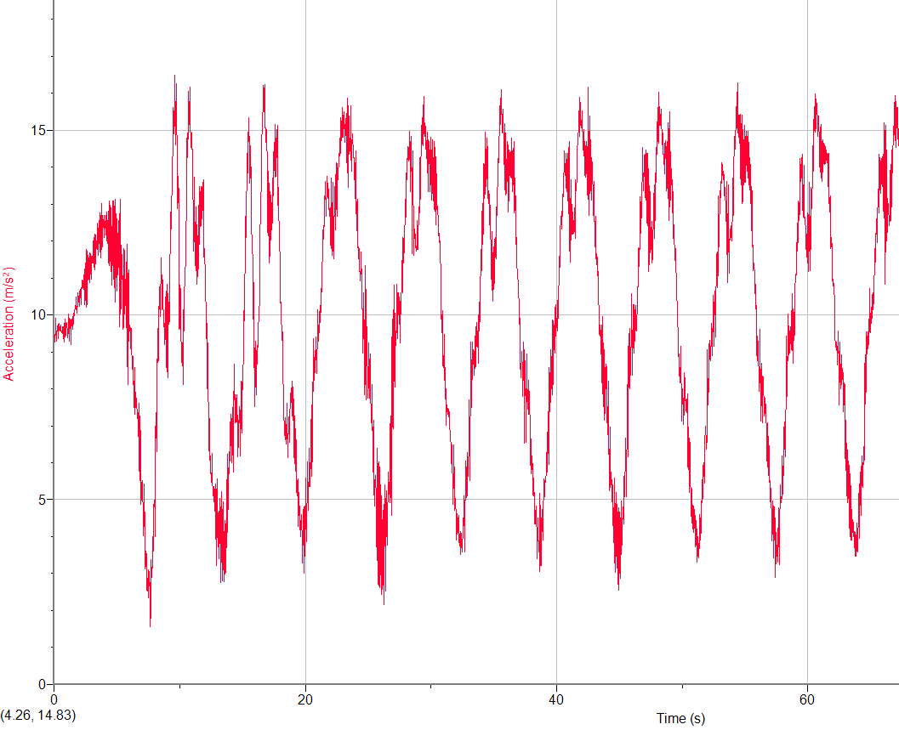

Slide 9
1. a. A carnival ride moves at a constant speed in a vertical circle. If the riders are feeling 2.60 "g"s at the bottom, what "g"s do they feel at the top, and what is the actual centripetal acceleration of the ride in "g"s? (Be sure to answer both questions)

Slide 10
2. a. A carnival ride moves at a constant speed in a vertical circle. If the actual centripetal acceleration of the ride in "g"s is 0.12 "g"s, what “g”s do the riders feel at the top, what "g"s do they feel at the bottom? (Be sure to answer both questions)

Slide 11
3. a. A carnival ride moves at a constant speed in a vertical circle. If the riders are feeling 0.31 "g"s inverted at the top, what "g"s do they feel at the bottom, and what is the actual centripetal acceleration of the ride in "g"s?
(Be sure to answer both questions)

Slide 12
4. a. A carnival ride moves at a constant speed in a vertical circle. If the riders feel 0.38 "g"s at the top, what is the centripetal acceleration of the ride in "g"s, and what "g"s do they feel at the bottom (Be sure to answer both questions)

Slide 13
5. a. A carnival ride moves at a constant speed in a vertical circle. If the riders are feeling 3.34 "g"s at the bottom, what "g"s do they feel at the top, and what is the actual centripetal acceleration of the ride in "g"s? (Be sure to answer both questions)

Slide 14
1. A carnival ride moves at a constant speed in a vertical circle. If the riders are feeling 0.85 "g"s inverted at the top, what "g"s do they feel at the bottom, and what is the actual centripetal acceleration of the ride in "g"s? (Be sure to answer both questions)

Slide 15
Ex2 – A 5.00 kg object goes 9.00 m/s in a 3.75 m radius vertical circle. Find the force needed at the top, and at the bottom.

Slide 16
Ex3 – An 9.0 kg mass moves at a uniform speed of 4.0 m/s in a 2.0 m radius circle on the end of a rod. What force is needed at the top and at the bottom?

Slide 17
Ex4 – A 1.15 kg mass moves at a uniform speed in a 3.78 m radius circle on the end of a rod. At the top, the rod is exerting a downward force of 5.02 N on the mass.
a) What is the centripetal acceleration of the mass?
b) What is its speed?
c) What force does the rod exert at the bottom?

Slide 18
Ex5 – A 1.50 kg mass moves at a uniform speed in a 2.00 m radius circle on the end of a rod. At the bottom, the rod is exerting an upward force of 25.0 N on the mass.
a) What is the centripetal acceleration of the mass?
b) What is its speed?
c) What force does the rod exert at the top?

