Slide 1
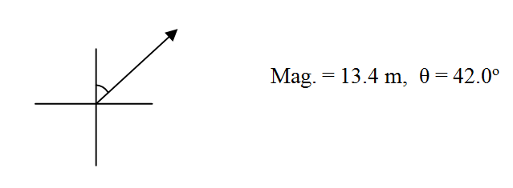
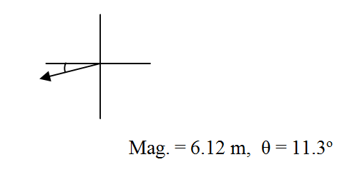
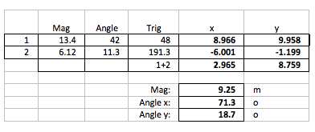

Slide 2
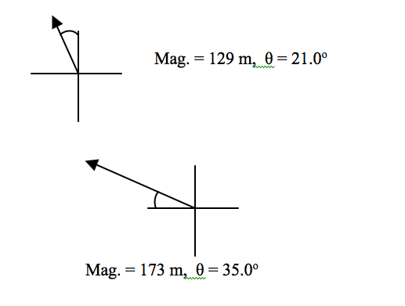
 | Mag | Angle | Trig | x | y
1 | 129 | 21 | 111 | -46.229 | 120.432
2 | 173.00 | 35.0 | 145.0 | -141.713 | 99.229
 |  |  | 1+2 | -187.943 | 219.661
 |  |  | Mag: | 289.09 | m
 |  |  | Angle x: | 49.4 | o
 |  |  | Angle y: | 40.6 | o

Slide 3
