Slide 1
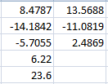
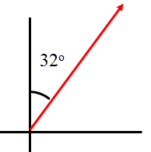
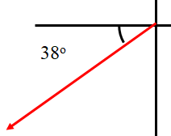
Add these two vectors
(6.22 m to the left and slightly up at 23.6º above the x axis)
16.0 m
A
B
18.0 m
Red Elk runs at 7.30 m/s off the edge of a 9.60 m tall cliff. With what speed does he hit the water? (15.5 m/s)

