Slide 1
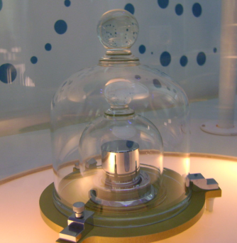
In this class we use mks units which stands for:
(AKA “SI” or Système international (d'unités))
Metres – the distance traveled by light in 1/299,792,458 of a second. (or 3.281 feet)
Kilograms – 1000 grams – the mass of one litre of water at 4 ºC. Weighs 2.2 lbs on earth. (was a bar of platinum in France, but since 2019 is actually defined now in terms of Planck’s constant)
Seconds – traditionally 1/86,400th of a day, but now the second is defined as being equal to the time duration of 9,192,631,770 periods of the radiation corresponding to the transition between the two hyperfine levels of the fundamental unperturbed ground-state of the caesium-133 atom. (no test on this…)

Slide 2
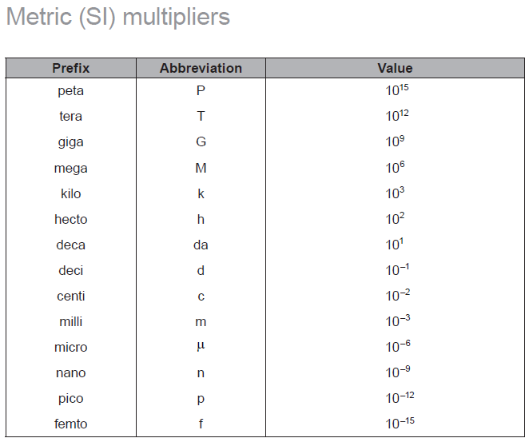
(Prefixes)
IB will use these
kg = 1000 g
Dad jokes:
10⁹ bulls
10⁻¹² boos
10¹ dents
10⁻² or 10⁻³ pedes
10⁶ malls
10⁻⁶ scopes
2x10³ mockingbirds

Slide 3
What is 23.7 cm in meters?
0.237 m

Slide 4
What is 1.28 m in centimeters?
128 cm

Slide 5
What is 50.0 mm in meters?
0.0500 m

Slide 6
What is 16.2 cm in millimeters
162 mm

Slide 7
What is 0.235 Joules in millijoules? (mJ) – It’s a unit of energy
235 mJ

Slide 8
How much of a meter is 256 nm?
256x10⁻⁹ m or 2.56x10⁻⁷ m in proper scientific notation.

Slide 9
How big is a 150 microfarad capacitor? (μF)
a 50.0 pF capacitor?
235 mJ

Slide 10
The radius of the hydrogen nucleus is 1.20x10⁻¹⁵ m. Write that using a proper SI multiplier. (This is known as the Fermi Radius – it’s in your data packet)
1.20 fm

Slide 11
Write 12.6 MW (megawatts) in proper scientific notation.
1.26x10⁷ W

Slide 12
Write 3150 μm in proper scientific notation.
3.15x10⁻³ m

