Slide 1
Suppose a car goes 30.0 m ± 0.5 m in 3.1 ± 0.2 seconds.
Their speed would be 30/3.1 or about 9.68 m/s (Which is about 21.6 mph)
Two Questions:
What is the uncertainty of that speed?
Which is more uncertain, the distance, or the time?

Slide 2
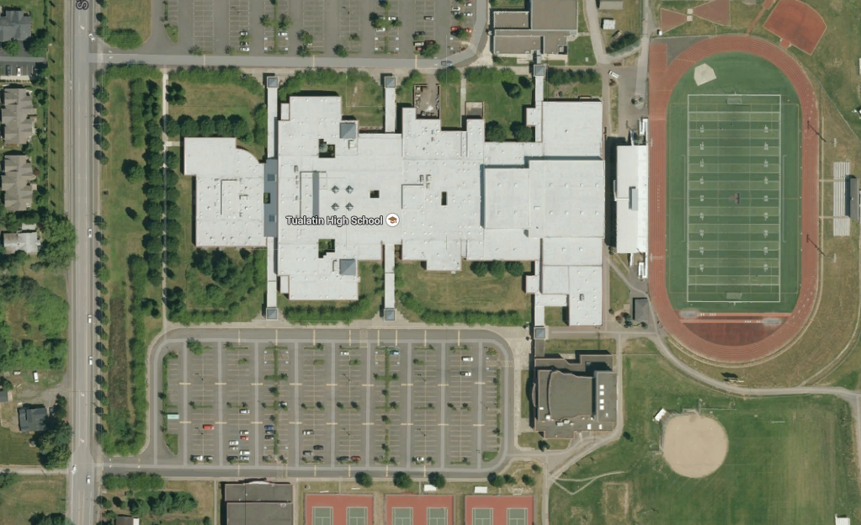

Slide 3
If
then
So

