Slide 1
The “g” force of the ride adds to the 1g we feel normally:
Feel 1g - ride
Feel 1g + ride

Slide 2
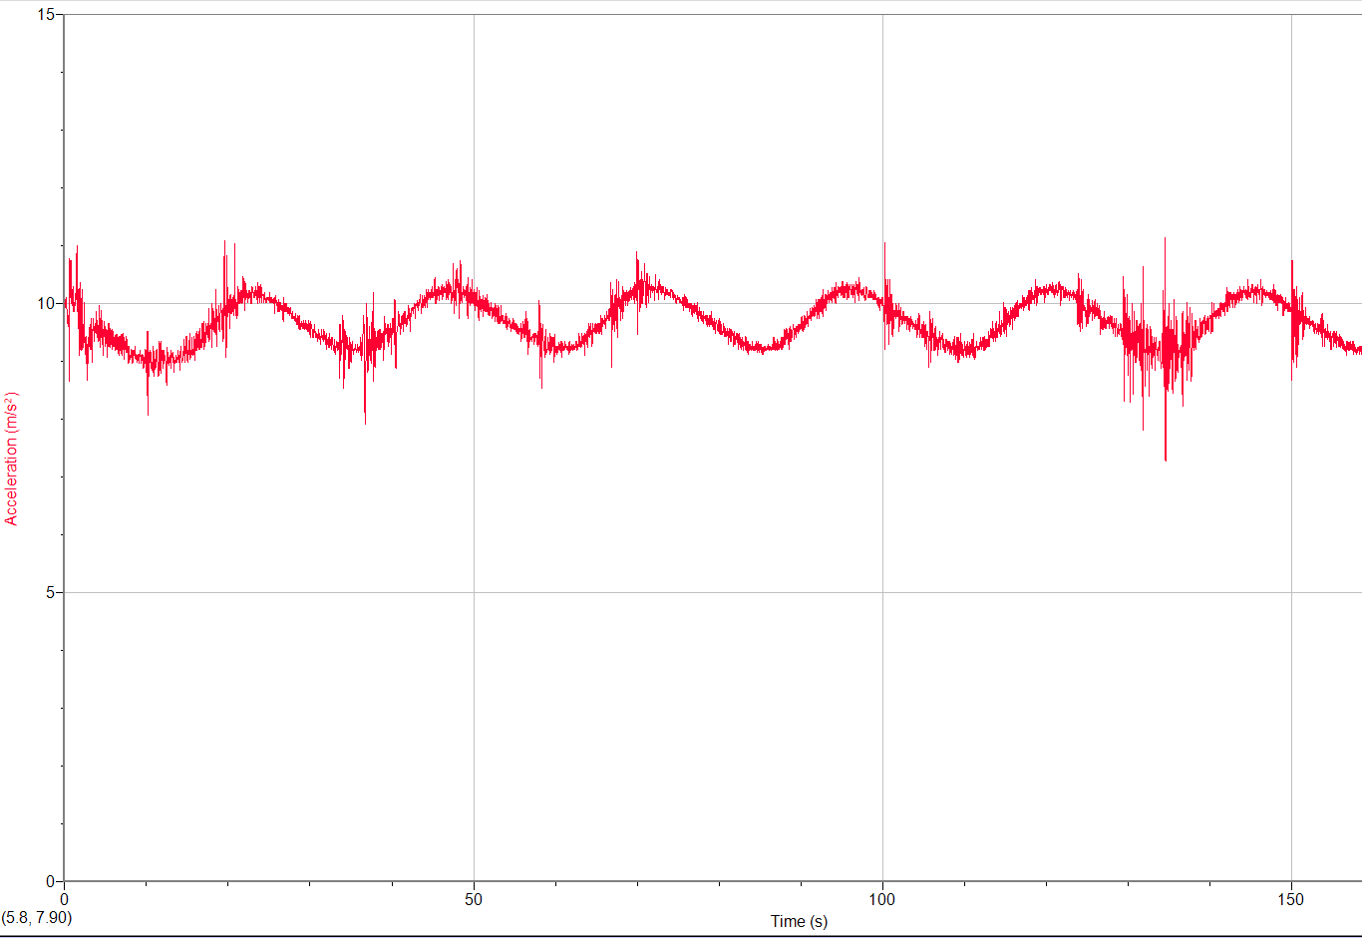
e.g. the Ferris wheel pulls about 0.10 “g”s

Slide 3
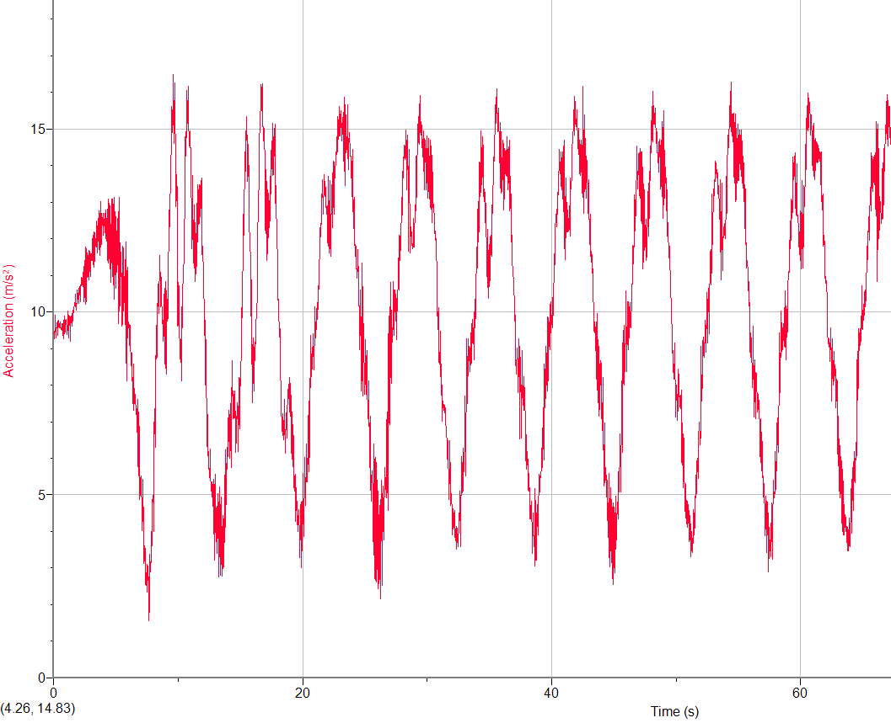

Slide 4
