Slide 1
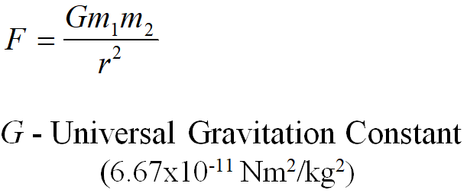
1. a. What is the force of attraction between a 6.90x10²⁵ kg planet, and its 4.30x10²² kg moon if their centers are separated by 5.70x10⁸ m? (6.09x10²⁰ N)

Slide 2
b. A wrecking ball's center is 5.00 m from the center of a 62.0 kg mass. What is the mass of the wrecking ball if there is a force of attraction of 2.30x10⁻⁸ N between them? (139 kg)

Slide 3
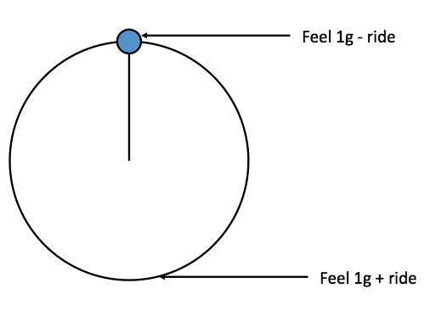
c. Riders on a Ferris wheel measure 1.200 "g"s at the bottom of the ride. What "g"s do the riders feel and measure at the top, and how many "g"s is the ride really pulling? What is the acceleration of the ride in m/s/s? (0.800 "g"s, 0.200 "g"s, 1.96 m/s/s)
Top: Measure = 1-ride Bottom: Measure = 1+ ride

Slide 4
d. A Ferris wheel has a radius of 7.80 m, and a period of 9.00 s. What "g" force do they read at the top and bottom of the ride? (0.612 "g"s, 1.388 "g"s)
Top: Measure = 1-ride Bottom: Measure = 1+ ride
1. Find ac
2. Convert to "g"s (divide m/s/s by 9.8 m/s/s)
3. Top: 1-ride, Bottom: 1+ride

Slide 5
e. A 3.10 m radius vertical circle ride that holds its riders upside down at the top makes riders feel 2.60 "g"s at the bottom of the ride. What is the tangential velocity of the ride? (6.97 m/s)
Top: Measure = 1-ride Bottom: Measure = 1+ ride
1. Find the "g"s of the ride: Top: 1-ride, Bottom: 1+ride
2. Convert to "g"s (multiply "g"s by 9.8 m/s/s)
3. Use formulas to find v or T

Slide 6
2. a. What is the force of attraction between a 7.20x10²⁵ kg planet, and its 2.20x10²² kg moon if their centers are separated by 9.50x10⁸ m? (1.17x10²⁰ N)

Slide 7
b. A wrecking ball's center is 7.00 m from the center of a 56.0 kg mass. What is the mass of the wrecking ball if there is a force of attraction of 6.40x10⁻⁸ N between them? (839.6 kg)

Slide 8
c. A Ferris wheel is pulling 0.170 "g"s of centripetal acceleration. What "g"s do the riders feel and measure at the top and bottom of the ride? What is the acceleration of the ride in m/s/s? (0.830 "g"s, 1.170 "g"s, 1.67 m/s/s)
Top: Measure = 1-ride Bottom: Measure = 1+ ride

Slide 9
d. A vertical circle ride that holds its riders upside down at the top has a radius of 9.20 m, and a period of 4.60 s. What "g" force to the riders feel and measure at the top and at the bottom of the ride? (-0.751 "g"s (inverted), 2.751 "g"s)
Top: Measure = 1-ride Bottom: Measure = 1+ ride
1. Find ac
2. Convert to "g"s (divide m/s/s by 9.8 m/s/s)
3. Top: 1-ride, Bottom: 1+ride

Slide 10
e. Riders at the bottom of the Ferris wheel measure a "g" force of 1.320 "g"s. What is the tangential velocity of the ride if the radius is 7.50 m? (4.85 m/s)
Top: Measure = 1-ride Bottom: Measure = 1+ ride
1. Find the "g"s of the ride: Top: 1-ride, Bottom: 1+ride
2. Convert to "g"s (multiply "g"s by 9.8 m/s/s)
3. Use formulas to find v or T

Slide 11
3. a. What is the force of attraction between a 6.80x10²⁴ kg planet, and its 4.80x10²¹ kg moon if their centers are separated by 2.30x10⁸ m? (4.12x10¹⁹ N)

Slide 12
b. A wrecking ball's center is 2.00 m from the center of a 54.0 kg mass. What is the mass of the wrecking ball if there is a force of attraction of 9.30x10⁻⁷ N between them? (1032.8 kg)

Slide 13
c. Riders on a Ferris wheel measure 0.910 "g"s at the top of the ride. What "g"s do the riders feel and measure at the bottom, and how many "g"s is the ride really pulling? What is the acceleration of the ride in m/s/s? (1.090 "g"s. 0.090 "g"s, 0.882 m/s/s)
Top: Measure = 1-ride Bottom: Measure = 1+ ride

Slide 14
d. A Ferris wheel has a radius of 8.20 m, and a tangential velocity of 4.50 m/s. What "g" force do they read at the top and bottom of the ride? (0.748 "g"s, 1.252 "g"s)
Top: Measure = 1-ride Bottom: Measure = 1+ ride
1. Find ac
2. Convert to "g"s (divide m/s/s by 9.8 m/s/s)
3. Top: 1-ride, Bottom: 1+ride

Slide 15
e. A vertical circle ride that holds its riders upside down at the top has a radius of 5.30 m and generates an inverted "g" force of
-0.420 "g"s at the top. What is the period of the ride? (3.88 s)
Top: Measure = 1-ride Bottom: Measure = 1+ ride
1. Find the "g"s of the ride: Top: 1-ride, Bottom: 1+ride
2. Convert to "g"s (multiply "g"s by 9.8 m/s/s)
3. Use formulas to find v or T

Slide 16
question

