Slide 1
Formative Assessment

Slide 2
1. What is the radius of the orbit that has an orbital velocity of 1020 m/s around the earth? (m = 5.97 x 10²⁴ kg) (3.83 x 10⁸ m)

Slide 3
2. What is the radius of a luno-synchronous orbit? (T = 2.36 x 10⁶ s, moon’s mass is 7.36 x 10²² kg)
(8.85 x 10⁷ m)

Slide 4
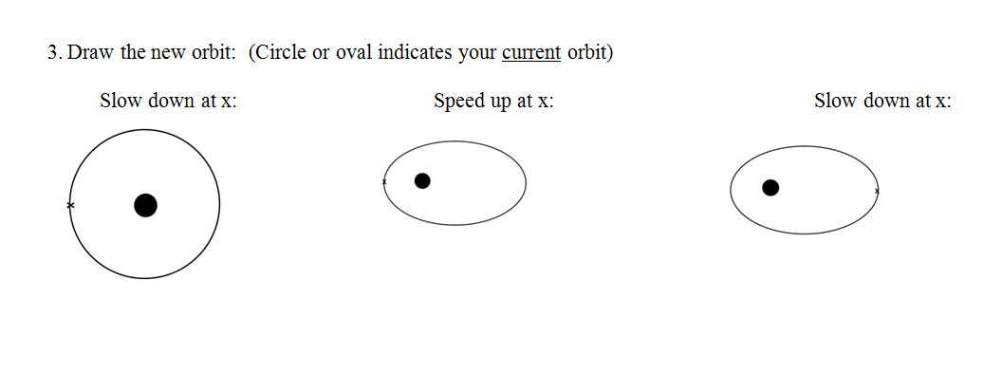

Slide 5
question

