Slide 1
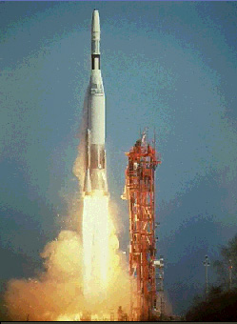
Rocket Propulsion
© Microsoft Encarta

Slide 2
Rocket Propulsion
So:
F = engine thrust
Δ t = time to burn fuel
m = mass of fuel burned
Δv = exhaust gas velocity
FΔt
=
mΔv

Slide 3
Rocket Propulsion
Example 1: A rocket burns fuel at a rate of 1.2 kg/s, with an exhaust velocity of 1250 m/s. What thrust does it develop?
FΔt = mΔv
Δv = 1250 m/s
m = 1.2 kg
Δt = 1 s
(F)(1 s) = (1.2 kg)(1250 m/s), F = 1500 N
1500 N

Slide 4
Rocket Propulsion
Example 2: A model rocket engine develops 12 N of thrust with an exhaust velocity of 718 m/s. What is its fuel burn rate?
FΔt = mΔv
F = 12 N
Δv = 718 m/s
m = ? kg
Δt = 1 s
(12 N)(1 s) = m(718 m/s), m = 0.0167 kg
Burn rate = 0.0167 kg/s
0.0167 kg/s

Slide 5
Whiteboards
1-5

Slide 6
A rocket burns 1.50 kg of fuel in 11.8 seconds with an exhaust velocity of 925 m/s. What thrust does it develop?
117.6 N

Slide 7
A rocket burns 12.0 kg of fuel in 15.0 seconds generating a thrust of 580. N. What must be the exhaust velocity?
725 m/s

Slide 8
A certain rocket engine burns 35.2 grams of fuel per second with an exhaust velocity of 725 m/s. What thrust does it generate?
F = mΔv, F= (.0352 kg/s)(725 m/s)
Δt
F = 25.52 N
25.52 N

Slide 9
A D12 engine generates 11.80 N of thrust burning fuel at a rate of 14.3 grams per second. What is the exhaust velocity?
F = mΔv, 11.80 N = (.0143 kg/s) Δv
Δt
Δv = (11.80 N)/(.0143 kg/s)
= 825.2 m/s
825.2 m/s

Slide 10
The Saturn V’s first stage engines generated 33.82 MN of thrust (33.82 x 10⁶ N) with an exhaust velocity of 2254.7 m/s. What was its fuel burn rate?
F = mΔv, 33.82E6 N= (?)(2254.7 m/s)
Δt
m = (33.82E6 N)/(2254.7 m/s) =
Δt 15,000 kg/s
15,000 kg/s

Slide 11
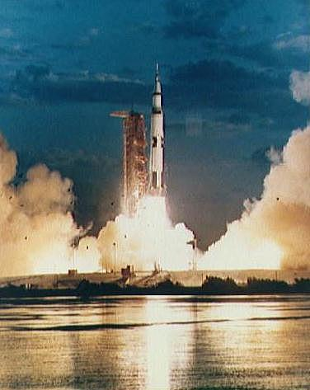
Saturn V Rocket - Apollo missions
Escape Tower
Command Module
L.E.M
Third stage
Second stage
First stage
Saturn V Animation (Flash in IE)

Slide 12
http://xkcd.com/1133/ - Up goer 5 – explanation using most common 1000 words

Slide 13
Example:
A rocket has a total mass of 6.00 kg, 4.80 kg of which is fuel. The engine burns the fuel in 26.2 s, with an exhaust velocity of 985 m/s.
What are the initial and final masses of the rocket?
What is the thrust of the engine?
What is the initial acceleration of the rocket?
What is the final acceleration of the rocket just before it runs out of fuel?
6.00 kg and 1.20 kg, 180.5 N, 20.3 m/s/s, 140.6 m/s/s

Slide 14
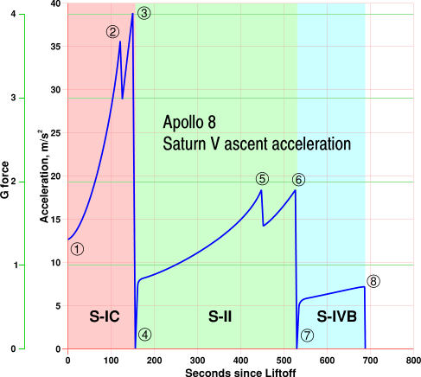
The marked events in the graph are: Launch with ignition of the S-IC. Note how the acceleration rapidly rises with increasing engine efficiency and reduced propellant load.
Cut-off of the centre engine of the S-IC.
Outboard engine cut-off of the S-IC at a peak of 4g.
S-II stage ignition. Note the reduced angle of the graph for although the mass of the first stage has been discarded, the thrust of the S-II stage is nearly one tenth of the final S-IC thrust.
Cut-off of the centre engine of the S-II.
Outboard engine cut-off of the S-II at a peak of approximately 1.8g.
S-IVB stage ignition. Note again the reduced angle of the graph caused by the thrust being cut by a fifth.
With the cut-off of the S-IVB's first burn, the vehicle is in orbit with zero acceleration.

Slide 15
Whiteboards
1-2

Slide 16
A 45 kg rocket burns 35 kg of fuel in 14 seconds with an exhaust velocity of 720. m/s. What are the initial and final accelerations of the rocket?
initial mass = 45, final = 10 kg, thrust = 1800 N a_{i} = 30.2 m/s/s, a_{f} = 170.2 m/s/s

Slide 17
A rocket with a mass of 120. kg contains 90.0 kg of fuel, and burs fuel at 5.10 kg/s with an exhaust velocity of 1120 m/s. What are the initial and final accelerations of the rocket?
initial mass =120, final = 30 kg, thrust = 5712 N a_{i} = 37.8 m/s/s, a_{f} = 181 m/s/s

Slide 18
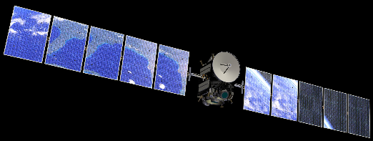
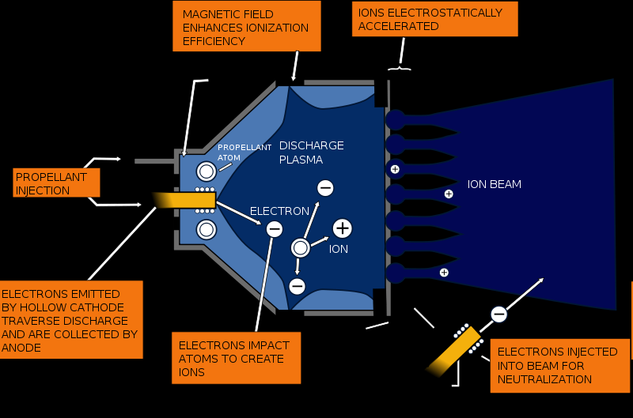
where’s the power come from?
Gridded Xenon ion drive (Like Dawn has)

Slide 19
The Dawn spacecraft has a mass of about 770 kg, and an ion drive with an exhaust velocity of 35,000 m/s that generates about 92 millinewtons of thrust. (.092 N)
How what is the “burn” rate for this engine?
Ft = mv
(.092 N)(1.0 s) = m(35,000 m/s)
m = 2.62857E-06 kg/s
How big a change in velocity can 50 kg of fuel give the spacecraft?
The final mass will be 770 – 50 = 720 kg, on the average the spacecraft will have a mass of 745 kg
So the delta v is approximately:
(745 kg)(Δv) = (50 kg)(35,000 m/s)
Δv ≈ 2350 m/s

Slide 22
old slides

Slide 23
Rocket Propulsion
m = Fuel burn rate (kg/s)
Δt
Example: A 2000 kg rocket burns 1500 kg of fuel in 12 seconds. What is its fuel burn rate? What are its initial and final masses?
125 kg/s, 2000 kg, 500 kg

Slide 24
Whiteboards
1 | 2 | 3

Slide 25
A 45 kg rocket burns 35 kg of fuel in 14 seconds. What is its fuel burn rate? What are its initial and final masses?
2.5 kg/s, 45 kg, 10 kg
35 kg = 2.5 kg/s
14 s

Slide 26
What time will it take a rocket that has a burn rate of 1200 kg/s to consume 56,000 kg of fuel?
46.7 s
56,000 kg = 1200 kg/s
Δt
Δt = 56,000 kg/1200kg/s = 46.7 s

Slide 27
A rocket with a mass of 60.0 kg burns fuel at a rate of 2.50 kg per second for 20. seconds. How much fuel does it burn? What are the initial and final masses of the rocket?
50.0 kg, 60.0 kg, and 10.0 kg

Slide 28
Rocket Propulsion
Skill # 2 – Relating burn rate and exhaust velocity to thrust
F = mΔv
Δt
Δv = Exhaust velocity
m = Mass burn rate
Δt

Slide 29
Rocket Propulsion
F = mΔv
Δt
Example: A model Rocket generates 6.1 N of thrust with a burn rate of .0012 kg/s. What is the exhaust velocity?
5083 m/s

Slide 30
Rocket Propulsion
mΔv = FΔt
Example: A rocket burns 12.5 kg of fuel in 5.60 seconds with an exhaust velocity of 718 m/s. What thrust does it develop?
1603 N

