Slide 1
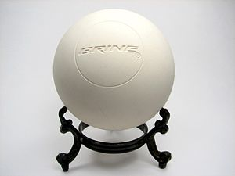
What is the momentum of a 147 g lacrosse ball going 52.0 m/s (7.64 kg m/s)
For what time do you need to need to exert 12.8 N of force to impart 7.644 Ns of momentum? (0.597 s)
A lacrosse player exerts 12.8 N of force on a 0.147 kg lacrosse ball for 0.600 seconds. What is the change in velocity of the ball? (52.2 m/s)
A lacrosse player catches a 0.142 kg ball thrown straight at them at 32.0 m/s, and throws it straight back at 48.0 m/s in 1.30 seconds. What is the average force they exerted? (8.74 N)

