Slide 1
QL 5.2.1 and QL 5.2.2

Slide 4
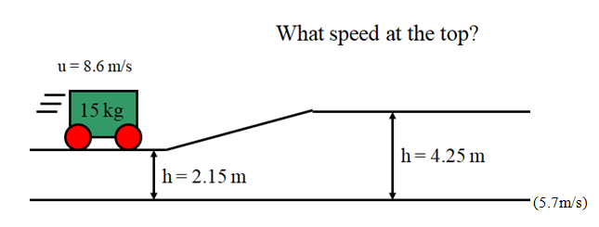

Slide 9
1) If you exert 15.0 N vertically upward a distance of 0.850 m on a 0.145 kg baseball, to what height above the starting point will it rise? Neglect friction, and assume the baseball was initially motionless.
1) 8.97 m, 2) 6.86 m/s, 3) 7509 N, 4) 8.11 m/s, 5) 2.64 m, 6) 0.445 N

Slide 10
2) A 2130 kg car coasts from rest down a small hill that is 2.40 m tall. What is the velocity of the car at the bottom? Neglect friction
1) 8.97 m, 2) 6.86 m/s, 3) 7509 N, 4) 8.11 m/s, 5) 2.64 m, 6) 0.445 N

Slide 11
3) A 0.440 kg hammer going 9.60 m/s horizontally strikes a nail, driving it into a wall 2.70 mm (0.00270 m) What force did it exert on the nail?
1) 8.97 m, 2) 6.86 m/s, 3) 7509 N, 4) 8.11 m/s, 5) 2.64 m, 6) 0.445 N

Slide 12
4) A 23.0 kg cart is going 5.70 m/s at the top of a 1.70 m tall hill. What speed does it have at the bottom?
Neglect friction
1) 8.97 m, 2) 6.86 m/s, 3) 7509 N, 4) 8.11 m/s, 5) 2.64 m, 6) 0.445 N

Slide 13
5) A 53.0 kg cart already going 4.20 m/s is given a forward push with a force of 82.0 N for a distance of
11.0 m. It then rolls up a hill. To what height will it roll before stopping? Neglect friction
1) 8.97 m, 2) 6.86 m/s, 3) 7509 N, 4) 8.11 m/s, 5) 2.64 m, 6) 0.445 N

Slide 14
6) A 0.113 kg pine cone falls from a height of 5.60 m. It strikes the ground at 8.10 m/s. What was the
average force of air friction slowing the pine cone as it fell?
1) 8.97 m, 2) 6.86 m/s, 3) 7509 N, 4) 8.11 m/s, 5) 2.64 m, 6) 0.445 N

Slide 15
7) A 12.0 kg cart is going 3.50 m/s on top of a 4.50 m tall hill. What is its speed on top of a 2.30 m tall
hill? Neglect friction
7) 7.44 m/s, 8) 7.32 m/s, 9) 723 N

Slide 16
8) A 26.0 kg kid sledding down a 2.70 m tall hill from rest gets a push of 78.0 N for 3.70 m. What is their speed when they are at an elevation of 1.10 m? Neglect friction
7) 7.44 m/s, 8) 7.32 m/s, 9) 723 N

Slide 17
9) A 45.0 kg cart going 6.20 m/s on the top of a 4.10 m tall hill is slowed at the bottom with by a braking force over a distance of 2.30 m until it is going only 6.70 m/s. What is the braking force?
7) 7.44 m/s, 8) 7.32 m/s, 9) 723 N

