Slide 1
Energy
Contents:
Definition
Types
Gravitational Potential
Whiteboards
Kinetic
Whiteboards

Slide 2
Energy - The ability to do work. (humor)
Makes things “go”
Neither created nor destroyed - moves around
Mostly Nuclear

Slide 3
Types of Energy
Potential - Energy of position. Stored energy.
Examples: Gravitational, chemical, springs, nuclear
Kinetic - Energy of motion.
Examples: Baseballs, trains, cars, flywheels, bullets, hammers
Thermal - Random potential and kinetic energy of molecules and atoms.
Examples: Hot stuff
(( ))
(((
)))
((
))
(( ))
( )
( )

Slide 4
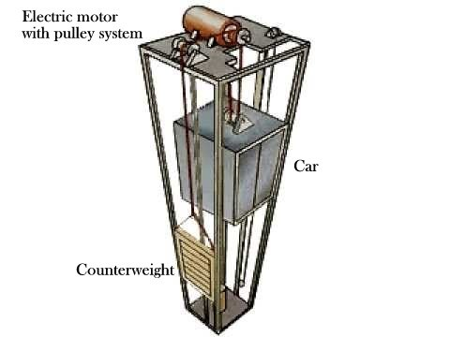

Slide 5
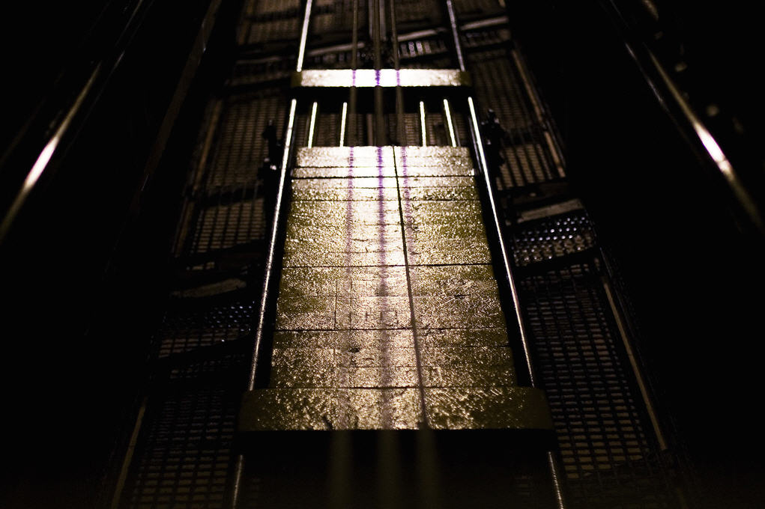

Slide 6
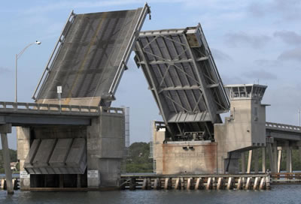
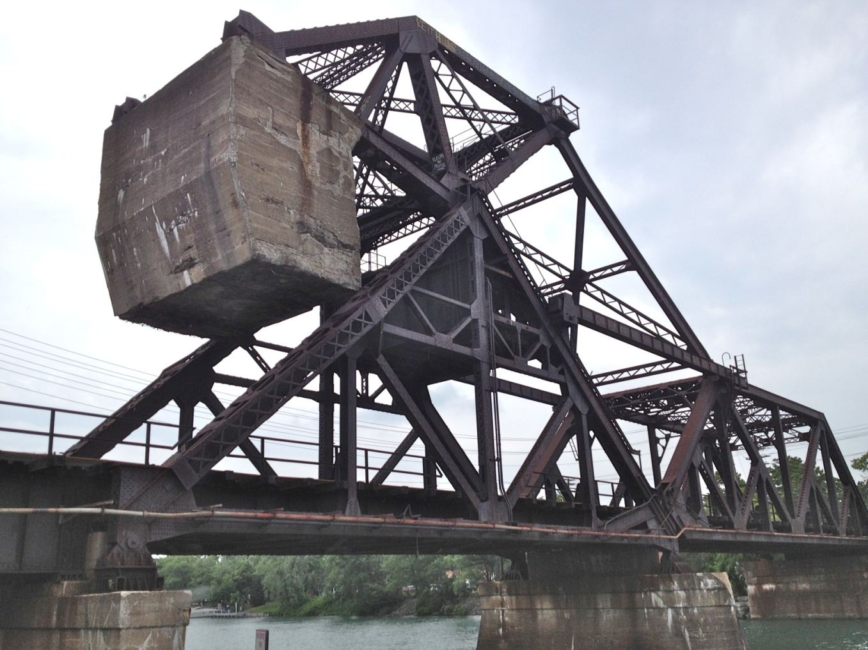

Slide 7
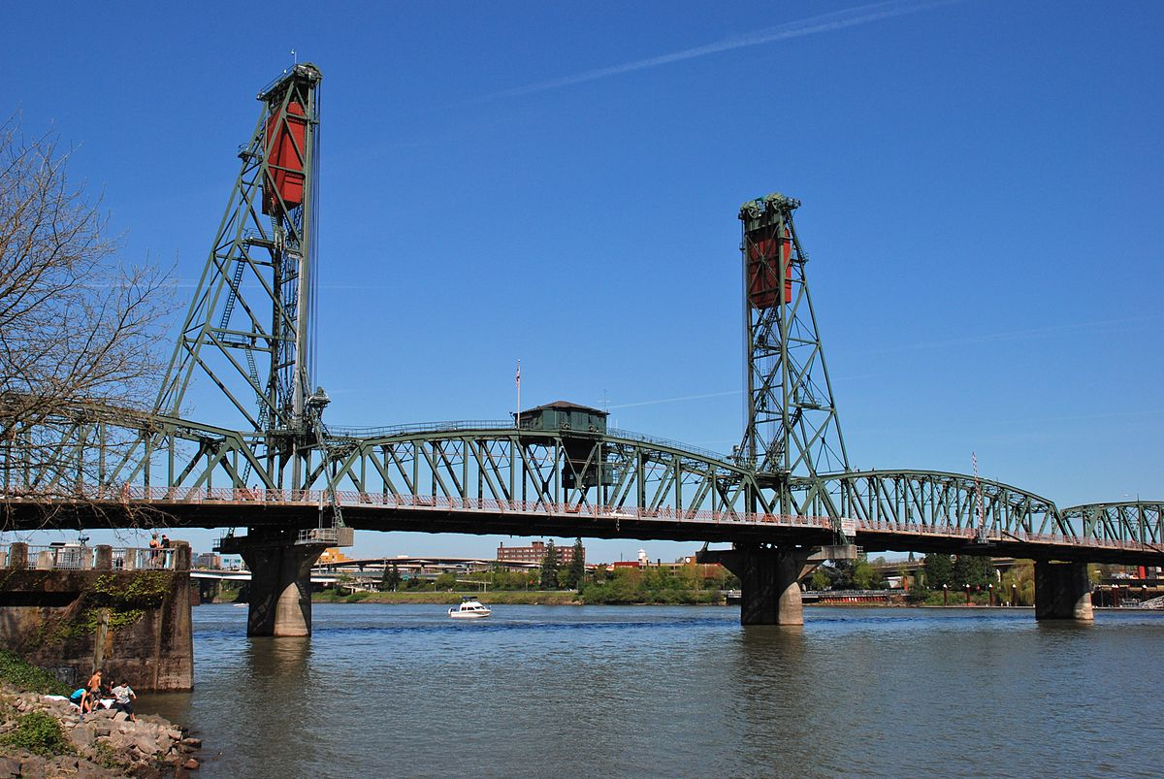

Slide 8
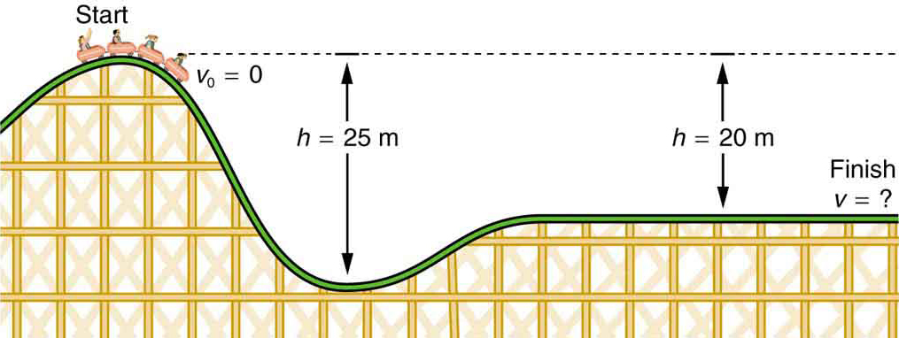

Slide 9
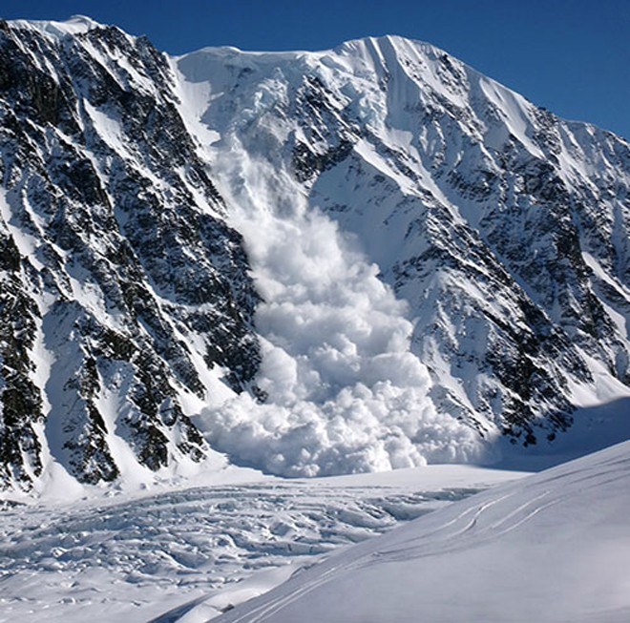

Slide 10
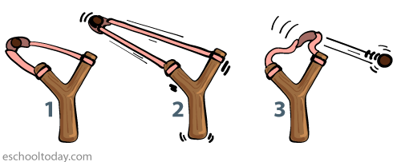
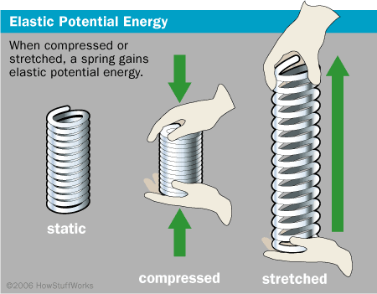
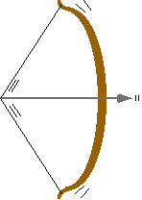

Slide 12
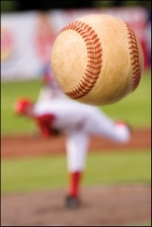

Slide 13
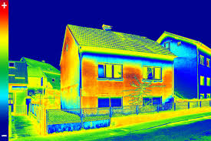

Slide 14
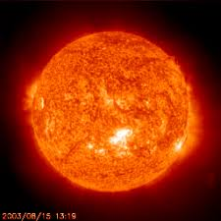
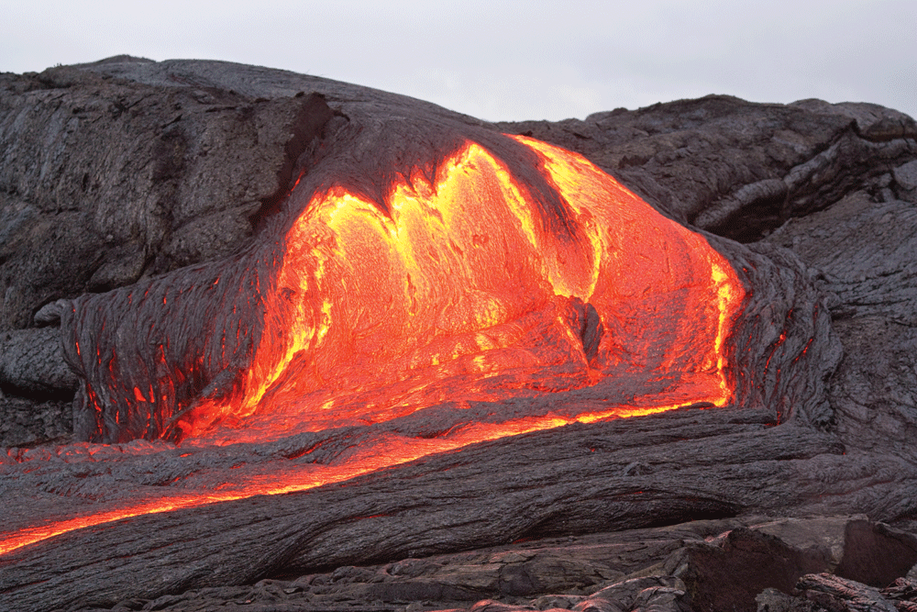

Slide 15
Gravitational Potential Energy
Lifting a box of mass m:
W = Fd= energy given
F = mg, d = h
W = Fd = mgh
m
h
PE = mgh
PE - gravitational potential energy
h - Height
m - Mass
g - 9.8 N/kg on Earth
There are
two ways
to lift the
object...

Slide 16
Whiteboards:
Gravitational Potential Energy
1 | 2 | 3

Slide 17
What is the potential energy of a 4.5 kg bowling ball, 13.5 cm above the ground?
PE = mgh, Δh = .135 m
PE = (4.5 kg)(9.8 N/kg)(.135 m) = 6.0 J
6.0 J

Slide 18
Toby Continued lifts a 75.0 kg box doing 1573 J of work. What is the change in height of the box?
PE = mgh
h = PE/(mg) = (1573 J)/(75 kg)/(9.80 N/kg)
= 2.14 m
2.14 m

Slide 19
Colin Host lifts himself up 15 m doing 9555 J of work. What is his mass?
PE = mgh
m = PE/(gh) = (9555 J)/(9.8 N/kg)/(15 m)
= 65 kg
65 kg

Slide 20
Kinetic Energy
v
d
F
m
Speeding up a box of mass m with force F
W = Fd = energy given
F = ma
W = (ma)d
v_{f}² = v_{i}² + 2ax, d = v²/(2a) (if v_{i} = 0)
W = (ma)(v²/(2a)) = mv²/2 = ¹/₂mv²
KE = ¹/₂mv²
KE = ¹/₂mv²
KE - Kinetic energy
v- velocity
m - mass
There are two ways to speed up the mass...

Slide 21
Whiteboards:
Kinetic Energy
1 | 2 | 3

Slide 22
What is the kinetic energy of a 4.20 g bullet going 965 m/s?
KE = ¹/₂mv² = ¹/₂(.0042 kg)(965 m/s)² = 1955.5725
(1960 J)
1960 J

Slide 23
A European swallow has 2.055 J of kinetic energy when it is flying at 14.23 m/s. What is its mass in grams?
KE = ¹/₂mv²
m = 2 E_{k}/v² = 2(2.055 J)/(14.23 m/s)² = .020297…
(20.29 g)
20.29 g

Slide 24
What speed must a .563 kg hammer move to store 34 J of energy?
KE = ¹/₂mv²
v = √(2 KE/m) = √(2(34 J)/(.563 kg)) = 11 m/s
11 m/s

