Slide 1
1. A baseball is going 35.0 m/s. What distance does it travel in 0.522 s? (18.3 m)

Slide 2
2. A car goes 45 m in 8.00 s. What is its velocity? (5.63 m/s)

Slide 3
3. Convert 13.0 m/s to feet/second (42.7 f/s)

Slide 4
4. A car going 12.0 m/s accelerates at 1.20 m/s/s for 3.2 s. What is its final velocity? (15.8 m/s)

Slide 5
5. A car going 24.0 m/s is going 17.0 m/s 11.0 seconds later. What was its acceleration? (-0.636 m/s/s)

Slide 7
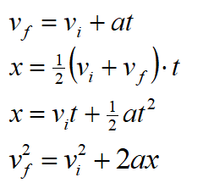
1. A moving giant lizard stops in 3.10 m in 1.20 s. What was its acceleration? (-4.31 m/s/s)

Slide 8
2. A car is going 26.0 m/s after traveling 145 m in 7.80 s. What was its initial velocity? (11.2 m/s)

Slide 9
3. A runner accelerates uniformly from 1.30 m/s to 4.70 m/s with an acceleration of 5.20 m/s/s. What was their displacement? (1.96 m)

Slide 10
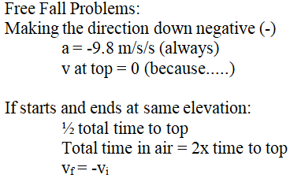
4-5. An air rocket leaves the ground going straight up with a velocity and reaches a height of 37.0 m before coming back down.
Neglect air friction and use g = 9.8 m/s/s
4. What was its launch velocity? (26.9 m/s)
5. What total time was it in the air? (5.50 s)

Slide 12
1-3: A ball is projected sideways from the top of a 12.0 m tall cliff. It lands having traveled a horizontal distance of 23.0 m.
1. What time is the ball in the air? (1.56 s)
2. What horizontal velocity did it have? (14.7 m/s)
3. Draw a picture of its velocity of impact and express it as an angle and a magnitude.(21.2 m/s 46.2º below horiz.)

Slide 13
4-5: A ball is launched at 26.0 m/s at an angle of 65.0º above horizontal on a level field.
4. What time is it in the air? (4.81 s)
5. What horizontal distance does it travel before striking the ground again (52.8 m)

Slide 15
1. A 13.0 kg mass accelerates along a frictionless track covering 45.0 m of distance in 2.30 s from rest. What net force was acting on the mass? (221.2 N)

Slide 16
2-3: A 2.50 kg mass hangs on a cord.
Use the convention that up is positive.
2. If the tension in the cord is 12.0 N, what is the acceleration of the mass? (-5.00 m/s/s)

Slide 17
2-3: A 2.50 kg mass hangs on a cord.
Use the convention that up is positive.
3. If the mass is accelerating downwards at 4.20 m/s/s, what is the tension in the cord? (14.0 N)

Slide 18
4-5: There is a coefficient of kinetic friction of 0.150 between a 8.00 kg block of wood and the level floor.
4. If there is a force of 9.20 N to the right, and the block is sliding to the right, what is the acceleration? Is it speeding up or slowing down? (Answer both questions)
(-0.320 m/s/s, decelerating, or slowing down)

Slide 19
4-5: There is a coefficient of kinetic friction of 0.150 between a 8.00 kg block of wood and the level floor.
5. What in what direction force is needed to make it slide and accelerate to the right at 4.90 m/s/s? (Answer both questions)
(51.0 N to the right)

