Slide 1
F_{f} = μR
These are approximate
What’s up with the two columns?
How are they related (one bigger = demo with force probe)

Slide 2
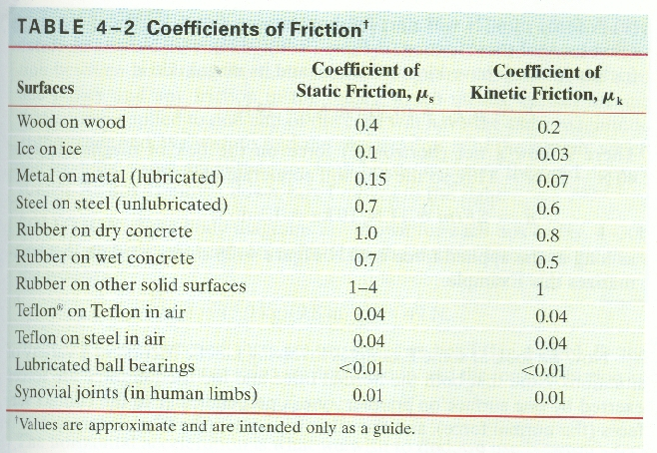
What force is needed to start to slide a 45.0 block of rubber across dry concrete?
441 N

Slide 3
What force is needed to continue to slide a 32.0 block of wood across a wood floor?
62.7 N

Slide 4
What force is needed to begin sliding a 921 kg block of ice across a frozen lake?
What force will it then take to keep it sliding?
903 N, 271 N

Slide 5
What force is needed to begin sliding a 2350 kg car across wet concrete?
16,121 N

Slide 6
What is the mass of ice you have if it takes 12.0 N of force to slide it at a constant speed?
40.8 kg

Slide 7
You have a 2.1 kg block of plastic and it takes you 8.65 N of force to slide it at a constant speed across your Formica table. What is the coefficient of friction?
0.42 N

