Slide 1
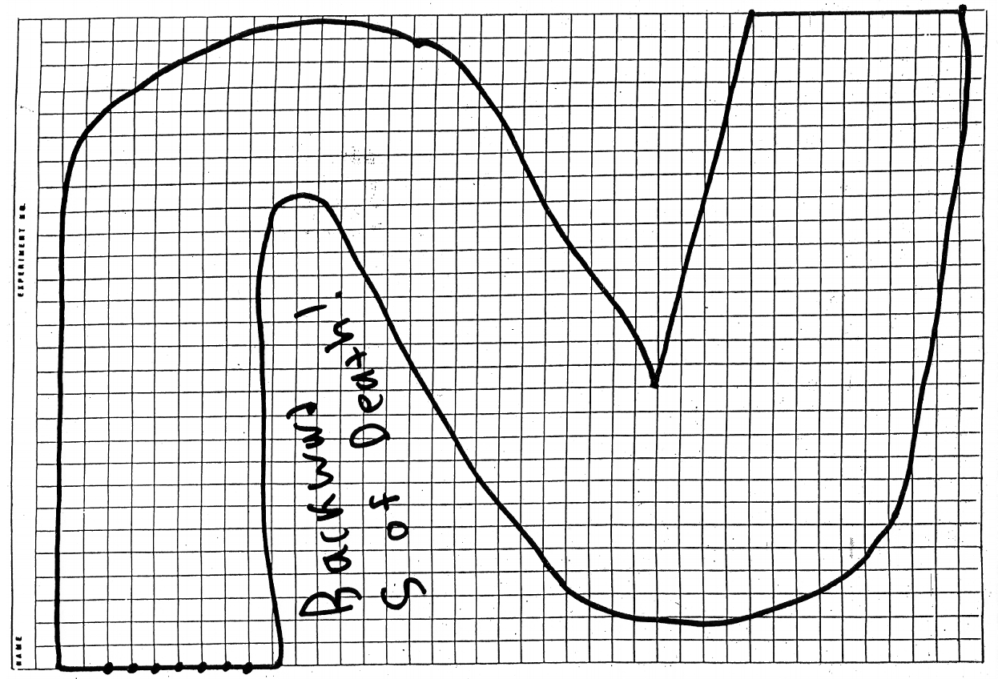
1. - Flip for first, other person chooses starting position
2. - Initial velocity is 0, 0
3. - Every turn you can change how much you move:
+1
0
-1
4. – If you crash, you lose. First one to cross the finish line wins!!

