Slide 1
Whiteboards:
Qualitative Position vs. time

Slide 2
What’s going on here?
5 m
Position in meters
Time in seconds
5 s

Slide 3
What’s going on here?
5 m
Position in meters
Time in seconds
5 s

Slide 4
What’s going on here?
5 m
Position in meters
Time in seconds
5 s

Slide 5
What’s going on here?
5 m
Position in meters
Time in seconds
5 s

Slide 6
What’s going on here?
5 m
Position in meters
Time in seconds
5 s

Slide 7
What’s going on here?
5 m
Position in meters
Time in seconds
5 s

Slide 8
What’s going on here?
5 m
Position in meters
Time in seconds
5 s

Slide 9
What’s going on here?
5 m
Position in meters
Time in seconds
5 s

Slide 10
What’s going on here?
5 m
Position in meters
Time in seconds
5 s

Slide 11
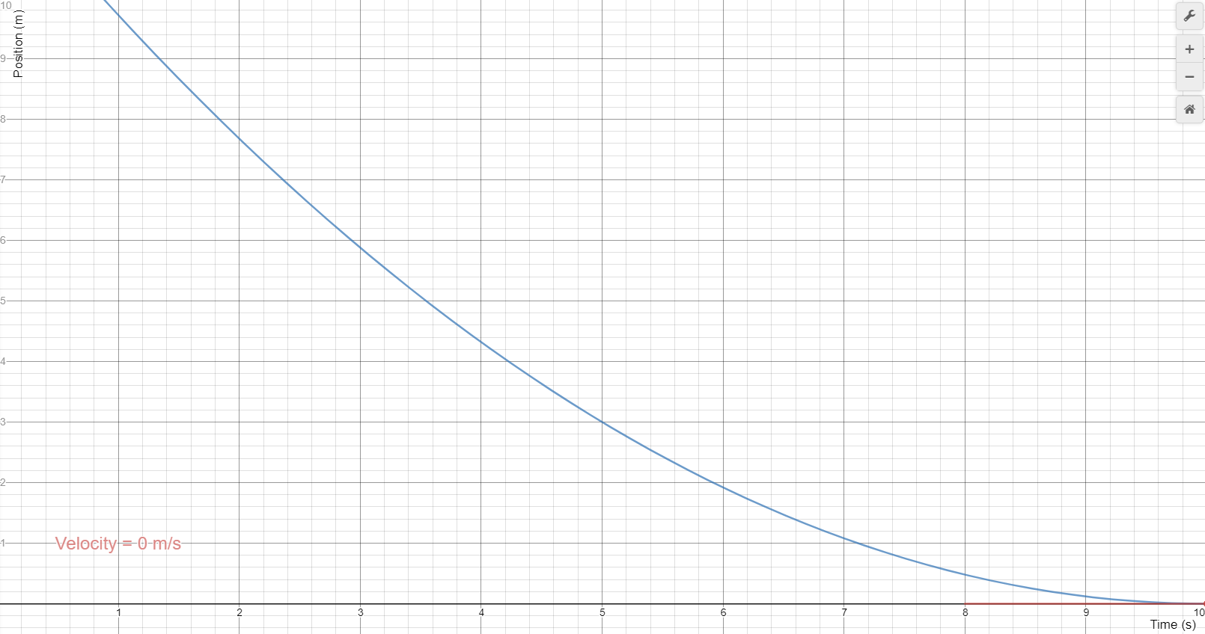
State what happens to the velocity, and whether this is + or - acceleration

Slide 12
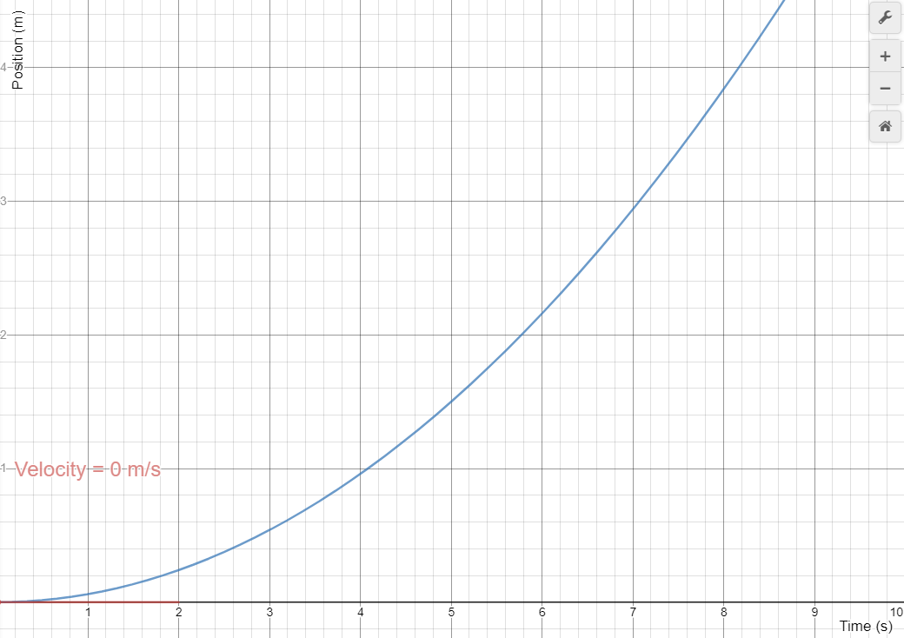
State what happens to the velocity, and whether this is + or - acceleration

Slide 13
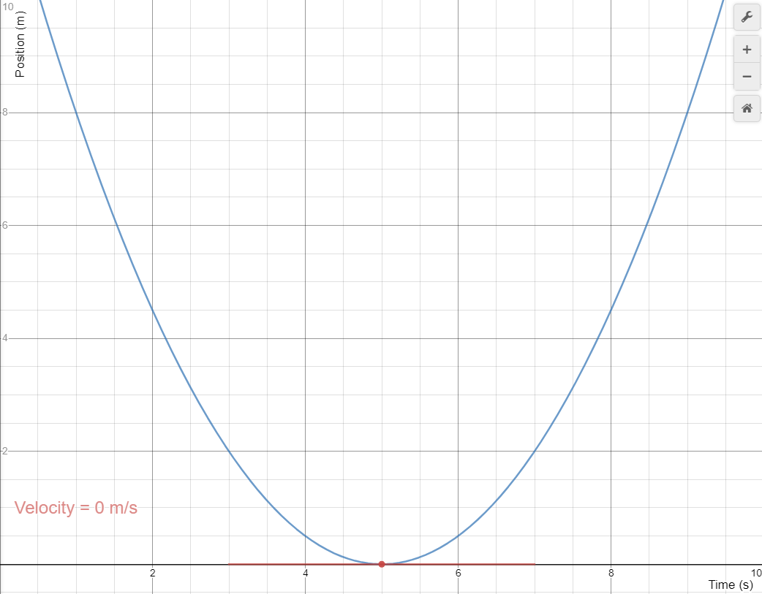
State what happens to the velocity, and whether this is + or - acceleration

Slide 14
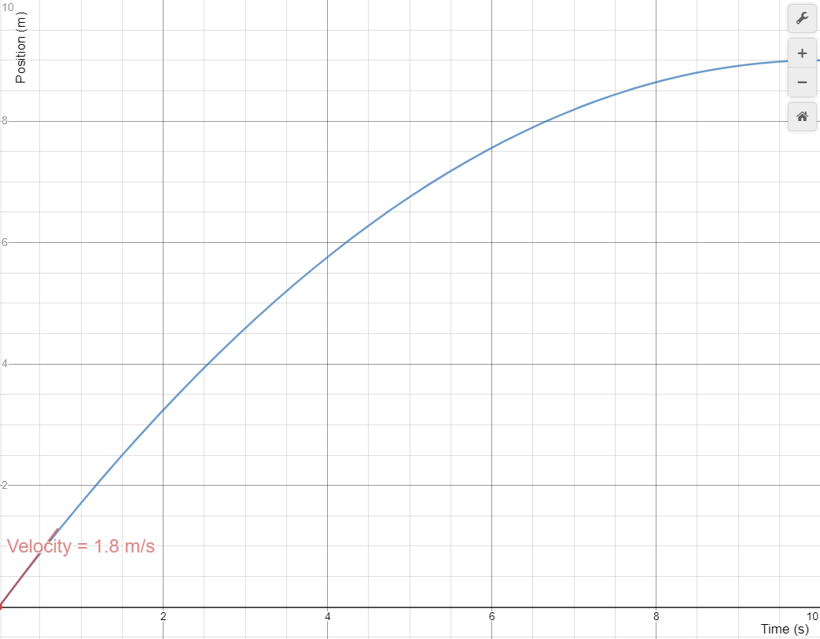
State what happens to the velocity, and whether this is + or - acceleration

Slide 15
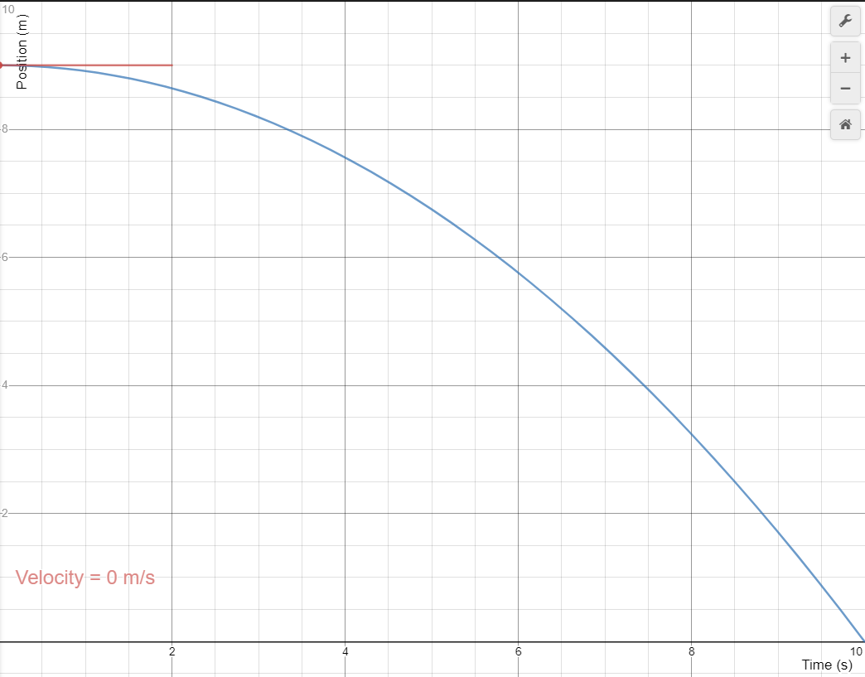
State what happens to the velocity, and whether this is + or - acceleration

Slide 16
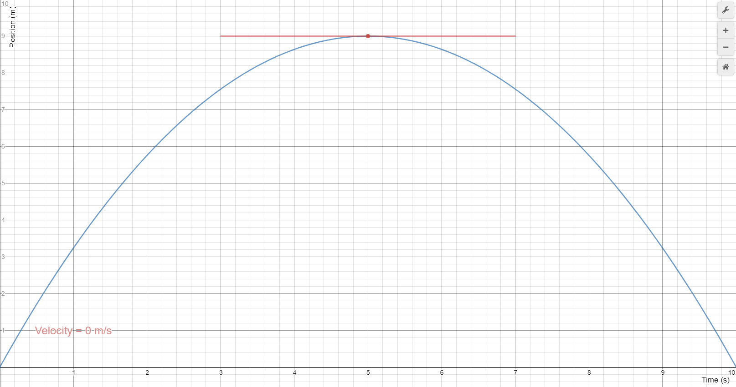
State what happens to the velocity, and whether this is + or - acceleration

Slide 17
Tangent Lines

Slide 18
v at 6.0 s =?
Find the tangent slope
5 m
Position in meters
5.1/5.95
.86 ms
Time in seconds
5 s

Slide 19
What is the velocity at 3.0 seconds?
5 m
Position in meters
Time in seconds
5 s
3/7.6 = .39 m/s

Slide 20
What’s the velocity at 6.0 seconds?
5 m
Position in meters
Time in seconds
5 s
-2.85/4.5 = -.62 m/s

Slide 21
What’s the velocity at 6.0 seconds?
5 m
Position in meters
Time in seconds
5 s
5.65/6.9 = .82 m/s

Slide 22
Whiteboards:
Qualitative Velocity vs. time

Slide 23
Velocity vs Time
+ V
0 m/s
- V
Time

Slide 24
What’s going on here?
+ V
0 m/s
- V
Time

Slide 25
What’s going on here?
+ V
0 m/s
- V
Time

Slide 26
What’s going on here?
+ V
0 m/s
- V
Time

Slide 27
What’s going on here?
+ V
0 m/s
- V
Time

Slide 28
What’s going on here?
+ V
0 m/s
- V
Time

Slide 29
What’s going on here?
+ V
0 m/s
Time

Slide 30
What’s going on here?
+ V
0 m/s
Time
What would this position graph look like?

Slide 31
Position
Time

Slide 32
Whiteboards

Slide 33
What direction is it going? Is it speeding up, or slowing down? State whether the acceleration is + or -
+ V
0 m/s
- V
Time

Slide 34
What direction is it going? Is it speeding up, or slowing down? State whether the acceleration is + or -
+ V
0 m/s
- V
Time

Slide 35
What direction is it going? Is it speeding up, or slowing down? State whether the acceleration is + or -
+ V
0 m/s
- V
Time

Slide 36
What direction is it going? Is it speeding up, or slowing down? State whether the acceleration is + or -
+ V
0 m/s
- V
Time

Slide 37
What direction is it going? Is it speeding up, or slowing down? State whether the acceleration is + or -
+ V
0 m/s
- V
Time

Slide 38
What direction is it going? Is it speeding up, or slowing down? State whether the acceleration is + or -
+ V
0 m/s
- V
Time

Slide 39
What direction is it going? Is it speeding up, or slowing down? State whether the acceleration is + or -
+ V
0 m/s
- V
Time

Slide 40
What direction is it going? Is it speeding up, or slowing down? State whether the acceleration is + or -
+ V
0 m/s
- V
Time

